Slide 1
Exploring Teacher Choice When Using an Instructionally Embedded Alternate Assessment System
Amy Clark, Meagan Karvonen,
Russell Swinburne Romine, & Brooke Nash

Slide 2
Session Overview
Background on the assessment system & population
Summary of teacher choice using instructionally embedded assessment during 2016-2017
Implications and next steps

Slide 3
Assessment overview

Slide 4
Background
The DLM consortium administers assessments to students with significant cognitive disabilities
Five states participate in the integrated model blueprint, which provides summative results based on testing conducted throughout the year for English language arts and mathematics
Assessment designed to occur alongside instruction and inform subsequent instructional decision making

Slide 5
Creation of Instructional Plans
Teachers create instructional plans using an online system
They select the content standard and level at which they want to instruct and assess the student
  Alternate achievement standards are “Essential Elements”
Assessments are available at five levels, known as linkage levels, for each content standard
Initial Precursor
Distal Precursor
Proximal Precursor
Target
Successor

Slide 6
Assessments at Different Levels
Notes:
Here is one content standard and how the skill measured varies at the five linkage levels.
Goal of the system is to align instruction and assessment at a level that is suitable for the student’s needs

Slide 7
Blueprint
Flexible design is intended to allow teachers to assess students at a frequency and level that best meets their students’ needs, IEP goals, etc.
Standards are organized within Claims and Conceptual Areas of similar content
The blueprint specifies content standards available and guidelines for selection for each grade and subject
  E.g. Choose 3 standards within Conceptual Area 1.1
Notes:
Choose standards that make sense for instruction given IEP goals, instructional needs, etc.

Slide 8
Issues to Consider for Instructionally Embedded Assessments
Consider how we define fidelity in context of an assessment that intentionally allows for teacher choice in depth, breadth, and frequency of assessment
Examine differences in administration patterns and how they relate to student performance
Determine the implications for the validity of inferences made from results when there is intended flexibility in student testing experience
Notes:
just now have the first full year of implementation data so we are starting by understanding what teachers have chosen to do

Slide 9
Research Questions
When are the peak times during which teachers choose to administer more testlets?
Do teachers select the linkage level recommended by the system or a different level?
Which standards do teachers tend to choose from among those available on the blueprints?
To what extent do teachers assess the same student more than once on a standard?

Slide 10
Participation
13,334 students with significant cognitive disabilities from 5 states
4,241 teachers created instructional plans and administered testlets
Each instructional plan is measured by a 3-8 item testlet
  Measures a single content standard at a single linkage level selected by the teacher
Total of 201,348 testlets were administered during 2016-2017 instructionally embedded testing

Slide 11
Teacher choice within the system

Slide 12
RQ 1: Peak Testing Patterns
The 2016-2017 instructionally embedded window was available from September through February for teachers to administer assessments covering the full blueprint
Teachers have choice of when and how frequently to assess their students within that time period

Slide 13
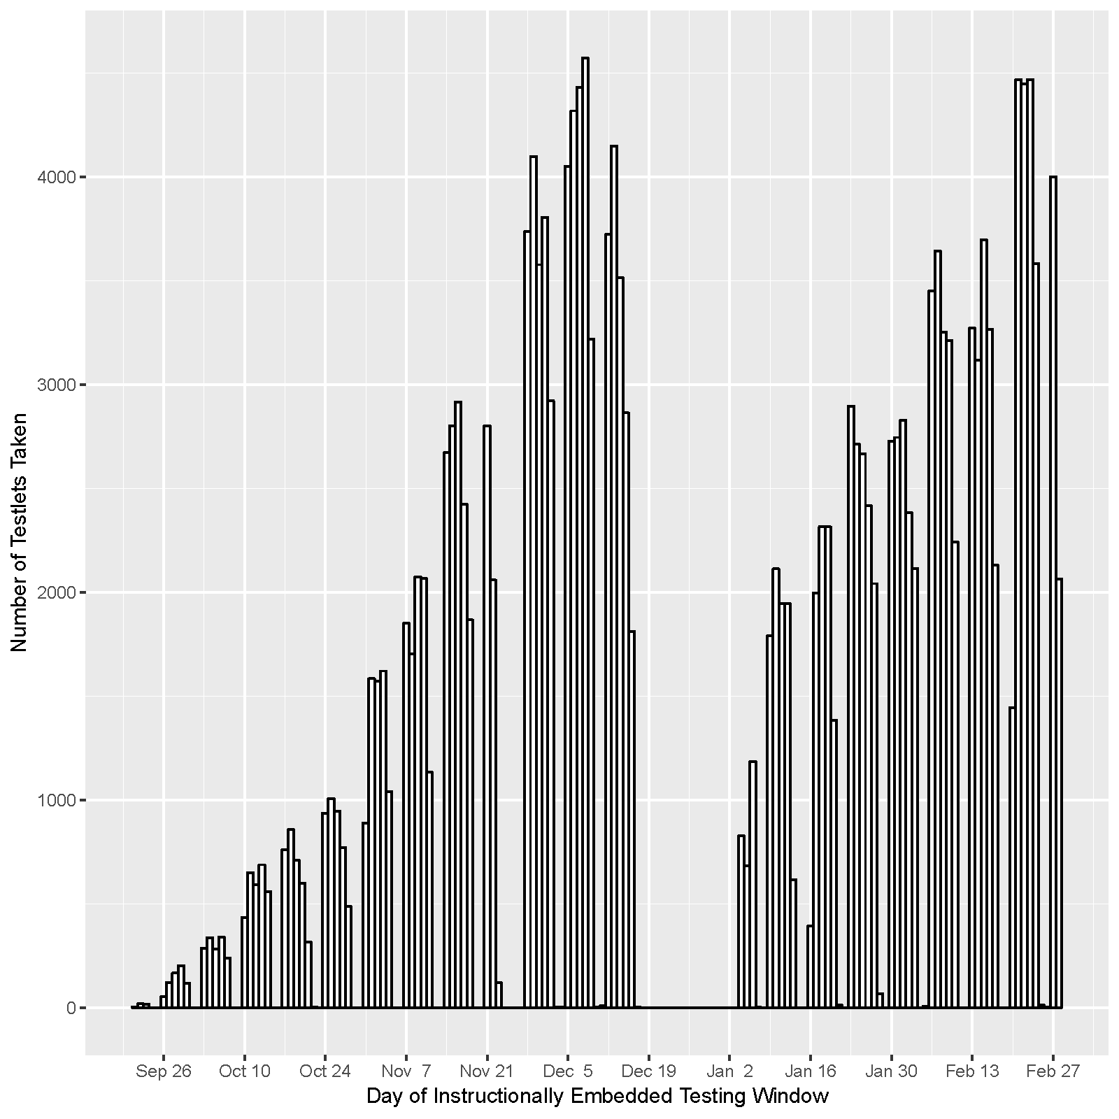
Peak Testing by Week
Notes:
When given the flexibility to test when they choose, most testlets were administered in the weeks leading up to winter break and to the end of the testing window.
Less frequent testing at the beginning of the window and immediately following the winter break may indicate greater fidelity, because the intention is for instruction to occur prior to assessment.

Slide 14
Average Number of Testlets Administered to Students per Week
Notes:
Across content areas
Based on students who tested in that week
Seems to indicate there may be two types of users:
Those who take a testlet or two per content area each week, likely as instruction occurs
Those who take all testlets in each content area in a week or two and do not further test (more of an interim testing model)

Slide 15
RQ 2: System-Recommended Linkage Level
Prior to testing, all teachers complete a survey for each student of learner characteristics
Responses to items in ELA, math, and expressive communication result in a complexity band for each content area
Four total complexity bands:
  Foundational, Band 1, Band 2, Band 3

Slide 16
Correspondence of Complexity Bands to System-Recommended Linkage Level
Foundational
Initial Precursor
Band 1
Distal Precursor
Band 2
Proximal Precursor
Band 3
Target
Successor
Teacher can choose to assign

Slide 17
ELA Adjustment from System-Recommended Level
Change | Foundational |  | Band 1 |  | Band 2 |  | Band 3
 | n | % | n | % | n | % | n | %
-3 | N/A | 0.0 | N/A | 0.0 | N/A | 0.0 | 347 | 3.0
-2 | N/A | 0.0 | N/A | 0.0 | 2,528 | 6.6 | 1,014 | 8.6
-1 | N/A | 0.0 | 7,437 | 20.9 | 6,429 | 16.7 | 1,867 | 15.9
0 | 13,352 | 88.8 | 25,363 | 71.4 | 27,389 | 71.3 | 8,190 | 69.8
1 | 965 | 6.4 | 2,049 | 5.8 | 1,646 | 4.3 | 315 | 2.7
2 | 487 | 3.2 | 463 | 1.3 | 426 | 1.1 | N/A | 0.0
3 | 140 | 0.9 | 215 | 0.6 | N/A | 0.0 | N/A | 0.0
4 | 85 | 0.6 | N/A | 0.0 | N/A | 0.0 | N/A | 0.0
n = instructionally embedded instructional plans
Notes:
Because the successor level is not recommended, a change of -4 levels from recommended is not available.
In most instances (approx 75%) , teachers did not adjust the level from what was recommended as indicated by the highlighted row
When teachers do adjust the linkage level from the level recommended, they tend to choose a testlet at one linkage level below the level assigned to the student.

Slide 18
Math Adjustment from System-Recommended Level
Change | Foundational |  | Band 1 |  | Band 2 |  | Band 3
 | n | % | n | % | n | % | n | %
-3 | N/A | 0.0 | N/A | 0.0 | N/A | 0.0 | 162 | 2.1
-2 | N/A | 0.0 | N/A | 0.0 | 2,420 | 6.1 | 598 | 7.8
-1 | N/A | 0.0 | 8,435 | 22.4 | 6,243 | 15.8 | 952 | 12.3
0 | 14,821 | 94.1 | 27,280 | 72.6 | 28,541 | 72.1 | 5,788 | 75.0
1 | 640 | 4.1 | 1,337 | 3.6 | 2,104 | 5.3 | 216 | 2.8
2 | 161 | 1.0 | 450 | 1.2 | 261 | 0.7 | N/A | 0.0
3 | 95 | 0.6 | 91 | 0.2 | N/A | 0.0 | N/A | 0.0
4 | 33 | 0.2 | N/A | 0.0 | N/A | 0.0 | N/A | 0.0
n = instructionally embedded instructional plans
Notes:
Math results are similar – teachers adjusted even less than in ELA

Slide 19
Testlets Administered at Each Linkage Level
Linkage Level | n | %
Initial Precursor | 49,502 | 24.6
Distal Precursor | 68,533 | 34.0
Proximal Precursor | 62,795 | 31.2
Target | 18,876 | 9.4
Successor | 1,642 | 0.8
Notes:
Teachers overwhelmingly chose to administer testlets to students at the lowest three linkage levels
Only 10% of testlets were administered at the T or S level regardless of system recommendation

Slide 20
RQ 3: Most Selected Standards
Blueprint incorporates teachers flexibility so that instruction and assessment occur in areas most relevant to the student’s instructional plan and IEP goals
Blueprint requirements allow teacher choice:
  e.g. Choose 3 EEs within Conceptual Area 1.1
Interested in which EEs teachers actually choose
  Implications for students’ opportunity to learn

Slide 21
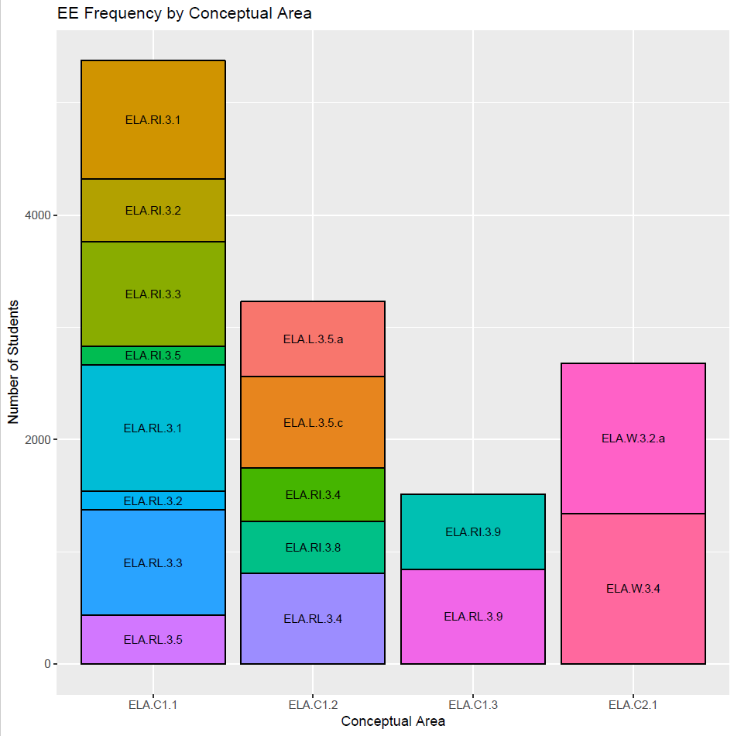
Grade 3 ELA example
Notes:
Writing EEs in Conceptual area 2.1 are required (and most selected accordingly) – More EEs available in C1.1, teachers tend to favor RL3.1 and avoid RI3.5 and RL 3.2
These findings may indicate decreased opportunity to learn the less-frequently chosen EEs or indicate an area for additional professional development support for teachers to feel comfortable instructing and assessing those content standards

Slide 22
RQ 4: Testing Same Standard Multiple Times
As instruction occurs, teachers can choose to create additional instructional plans to re-assess the content standard
  Can be at same linkage level or a different linkage level
Gets at idea of depth of instruction (versus breadth)

Slide 23
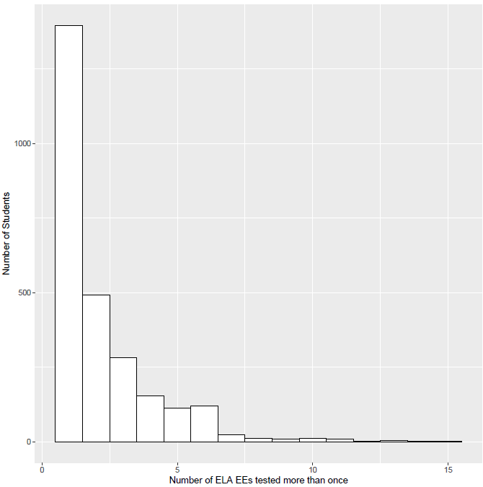
Given that a particular EE was tested on more than once, 90% of students tested on it twice
Notes:
This graph shows the number of EEs students tested on multiple times. Again, most students tested on two EEs multiple times – contributes to the overall picture of how much students were using the assessment system and how much information was available to teachers to inform instruction

Slide 24
Testing on Multiple Linkage Levels in a Standard
2,604 (19.5%) tested on more than one linkage level within a standard
Of students who assessed the same standard at more than one linkage level, most assessed at two different linkage levels (mean = 2.1, median = 2)
However, in 23 instances across all students and standards (0.01%), the students tested on all five linkage levels within the standard
Notes:
May be an indication of lack of understanding on teachers’ part about how system is intended to be used (e.g. not knowing the scoring model infers across levels tested so thinking students need to test at all levels to receive “credit”). Similarly, not wanting to frustrate IP level students on content that will be too challenging.

Slide 25
Frequency of Level Assessed More Than Once Across All Students and Standards
2.5% of the time, student tested on the same linkage level for the standard more than once
Linkage Level | n | %
Initial Precursor | 1,182 | 23.5
Distal Precursor | 1,641 | 32.6
Proximal Precursor | 1,569 | 31.2
Target | 633 | 12.6
Successor | 7 | 0.1
Notes:
In only 7 instances across all students and EEs was the successor level tested multiple times for the EE (i.e. more than one successor testlet administered for the EE)

Slide 26
Discussion

Slide 27
Summary of Results
Overall patterns of use show students have at least appropriate content coverage
Teachers generally do not override system recommendations
  System appears to assign testlets at the correct level for students to access the content
May still have practice in place of using system to meet requirements rather than to inform instruction
  AA-AAS historically seen as fulfilling legislative mandate rather than providing feedback on student performance (Nitcsh, 2013)

Slide 28
Implications for Fidelity
Expectation for some minimum threshold of use (e.g., full blueprint coverage)
To fulfill goal of informing instruction, ranges of actions are possible
  Retesting on a standard, if time lapse between tests and instruction occurred
  Testing fewer testlets in more weeks vs. in shorter, focused time blocks – may also be guided by state policies
What actions are outside the likely bounds of useful assessment?
  E.g., test on all standards and levels in a short time period

Slide 29
Next Steps
After spring 2017 data is collected:
  Is there a relationship between use of the instructionally embedded assessment system and students’ summative assessment results?
Teacher survey data collection currently underway to gain feedback on choices made during instructionally embedded testing and how progress reports were used to inform instruction
Defining a measure of implementation fidelity
Looking at within-student and within-teacher experience for testlet administration

Slide 30
THANK YOU!
For more information, please visit
dynamiclearningmaps.org
akclark@ku.edu

