Slide 1
Spring 2024 Dynamic Learning Maps® (DLM®) Alternate Assessment for Maryland
© 2024 Accessible Teaching, Learning, and Assessment Systems (ATLAS), the University of Kansas

Slide 2
Overview of Maryland’s spring 2024 DLM Assessment

Slide 3
Maryland Spring 2024 Assessment Window
March 11, 2024, to May 17, 2024
Data cleanup before and during the window
Testlets will not be delivered before the assessment window start date

Slide 4
Subjects and Grades Assessed
2023–2024 Maryland Assessment Requirements
Grade | ELA | Mathematics | Science
3 | Yes | Yes | No
4 | Yes | Yes | No
5 | Yes | Yes | Yes
6 | Yes | Yes | No
7 | Yes | Yes | No
8 | Yes | Yes | Yes
9, 10 | No | No | No
11 | Yes | Yes | Yes (Biology)

Slide 5
Kite Suite Updates

Slide 6
Data Extracts Overview
Used to monitor various aspects of the assessment
Accessed in Educator Portal via the Reports tab
Select the Data Extracts option
Previously listed on a single page
Now organized into tabbed categories

Slide 7
Student Information Tab
Extracts included
Current Enrollment
First Contact Survey File
PNP Setting Counts
PNP Settings
Roster
Student Roster and First Contact Survey Status

Slide 8
Test Administration and Monitoring Tab
Extracts included
DLM Test Administration Monitoring
TIP Access

Slide 9
Data Management Tab
Extracts included
Security Agreement Completion
Training Status
Users

Slide 10
End of Year Tab
This tab will provide the district-level General Research File (GRF).
Only DTCs will have the End of Year tab.

Slide 11
Reminders About Using Extracts
Select the New File button to update the resulting csv file each time updated information is needed.
Consult the Educator Portal User Guide for more information about extracts.

Slide 12
Removing Users in Educator Portal
Previously, the only options were to add, activate, or deactivate users.
District and building users will now be able to remove users in the Educator Portal interface. (Teachers cannot do this.)
No remove users template is provided.
Teachers cannot be removed if they have rosters.

Slide 13
Implications of Removing Users
Remove users if they are no longer teaching in your state.
Inactivate users if they are teaching in another district.
Users who have been removed will not appear in data extracts.
Only state-level users can restore a user that has been removed.

Slide 14
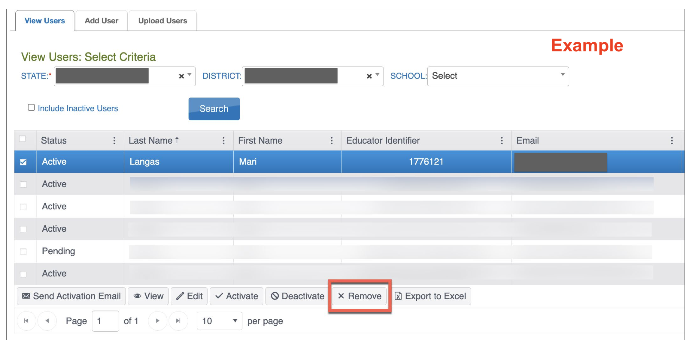
Educator Portal User Interface
Active, pending, and inactive users can be removed.

Slide 15
Steps to Remove Users in Educator Portal (1)
Select the Settings tab in Educator Portal and then the Users option.
Select the View Users tab.
Use the dropdown menus to populate the list of users and select the Search button.

Slide 16
Steps to Remove Users in Educator Portal (2)
Select the user(s) to be removed from the grid.
Select the Remove button below the grid.
Confirm the action when the pop-up message appears.

Slide 17
First Contact Surveys for Returning Students
Some items were revised for 2023-2024.
First Contact Surveys for returning students will be reset to Not Started.
All required items must be completed and submitted for all students.
A complete list of the First Contact Survey items is provided in the Test Administration Manual (see Appendix A).

Slide 18
Required Test Administrator Training

Slide 19
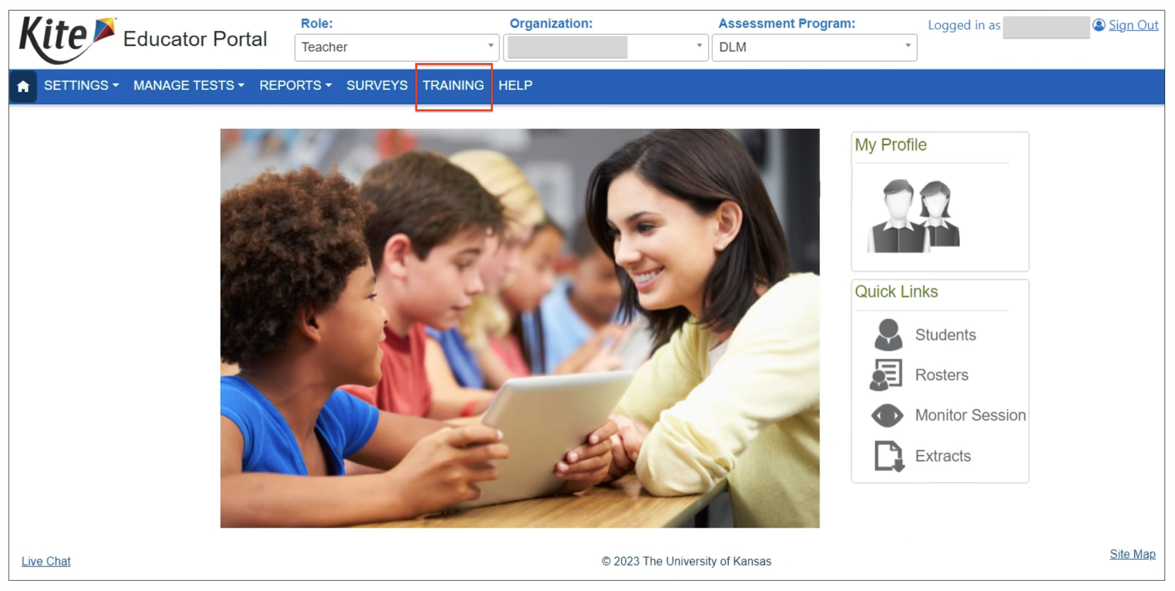
Accessing Required Test Administrator Training

Slide 20
Clarification: Training Access
New: Teachers will use the Training tab in Educator Portal to access the DLM Required Test Administrator Training.
Will not use the Training Courses link
Will only need to sign into Educator Portal

Slide 21
Launching the Course for Teachers

Slide 22
Quicker Completion Acknowledgement
Trainees can expect to have access to the Test Management tab in Educator Portal in about 30 minutes after accepting their completion certificate in the training course.
Previously, this took up to 3 hours.

Slide 23
Required Test Administrator Training Modules
 | Required Modules | Optional Modules | Additional Required Modules
Returning Teachers | 1* | 2 | 2
New Teachers | 4 | 2 | 2
*If the module is not passed, the returning teacher is directed to additional required training.

Slide 24
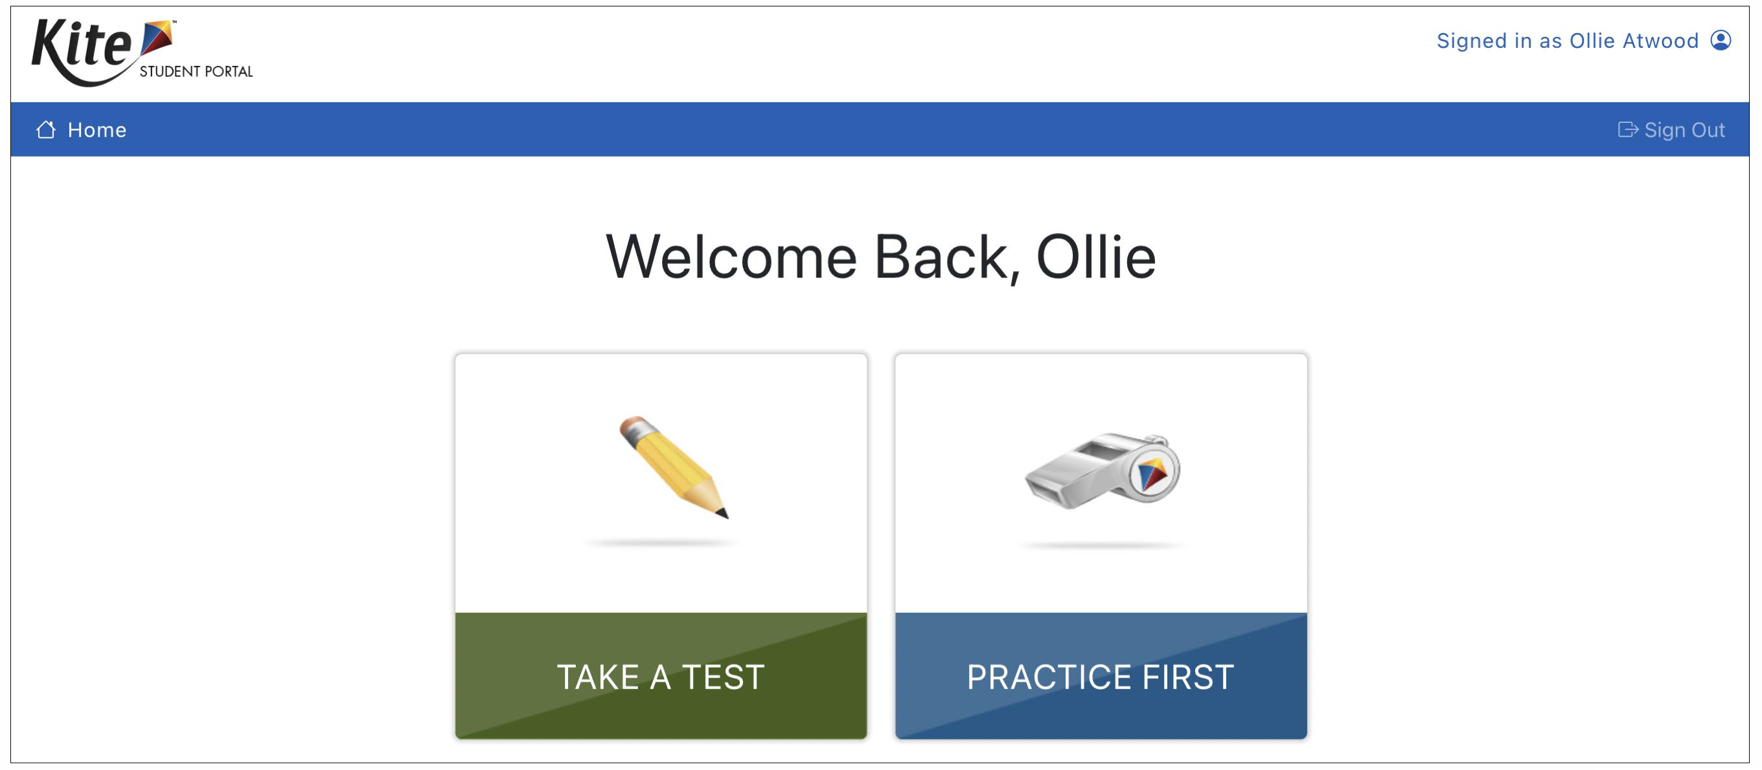
Slight Makeover, No Need to Reinstall
Student Portal 9.0.0 was used last school year and is still the current version.

Slide 25
Questions?

Slide 26
Scoring and reporting

Slide 27
Locating Score Reports (1)

Slide 28
Locating Score Reports (2)

Slide 29
Score Report Overview (1)
Teachers may view ISRs for students rostered to them for the current school year.
Score reports consist of Overall Results, Performance Profile, and a Learning Profile.

Slide 30
Score Report Overview (2)
The student’s performance in a subject is based on the number of skills mastered in relation to the total number of skills covered in the assessment.
This data, along with other student data, provides teachers with information to plan for instruction.

Slide 31
Overall Results (1)
The total number of skills that could be mastered for this grade and subject.
Provides evidence about what the child knows and can do.
Results are not a raw score or the number of items the student got correct.

Slide 32
Overall Results (2)
When talking to parents about overall results
provide examples of Essential Elements
provide academic examples of skills, which can be found in the mini-maps for each Essential Element
Essential Elements relate to what is being taught to grade-level peers.
Essential Elements are located on Maryland’s DLM webpage.
DLM does not provide a raw score.

Slide 33
Performance Profile (1)
Information about the student’s overall results.
Bar graphs in the Area section indicate the percent of skills mastered by area.

Slide 34
Performance Profile (2)
Conceptual areas are made up of groups of related Essential Elements.
Help identify broad areas of strengths and needs within the subject.
Useful in setting goals for the coming year.

Slide 35
Performance Profile (3)
When talking to parents about the performance profile
explain that At Target means the student has met the grade-level standard
focus on the student’s highest level of mastery
If parents/guardians are concerned about low performance, remind them that sometimes students demonstrate skills during the instruction but not during the assessment.

Slide 36
Learning Profile (1)
The Learning Profile shows the student’s mastery of certain skills, or levels, for each Essential Element.
The narrative at the top of the Learning Profile outlines the number of Essential Elements and conceptual areas tested out of the number expected for the grade and subject.

Slide 37
Learning Profile (2)

Slide 38
Learning Profile (3)
When talking to parents about the Learning Profile
explain that the Target is the grade-level expectation for all students
talk about the green boxes, focusing on what skills the student was able to show during the assessment
provide examples of how the student demonstrates knowledge of this skill during instruction

Slide 39
Mini-Maps (1)
Mini-maps support instruction by providing the learning pathways students may take as they approach the Target-level Essential Element.
Mini-maps give information about the knowledge and skills expected at each linkage level.
Mini-maps are in the Currently Tested Essential Elements document on Maryland’s DLM webpage.

Slide 40
Mini-Maps (2)
Learning Outcome: used to understand the expectation for students with the most significant cognitive disabilities
Linkage Level Descriptions: used to find knowledge, skills, and understandings related to the Essential Elements that are a good match for instruction

Slide 41
Mini-Maps (3)
Key Points
Mini-maps only show some knowledge, skills, and understandings.
Using student data along with mini-maps to inform instruction allows the student to move toward the Target level.
Mini-maps can be used in IEPs to document strengths and needs and inform possible goals.

Slide 42
Making Connections (1)
Using score reports, classroom data, and other data for each student provides teachers with information about where each student is performing.
Teachers will have other classroom and IEP data to add to information in the score report.

Slide 43
Making Connections (2)
Data helps teachers make decisions on providing high-quality instruction based on each student’s unique needs.
Using the mini-maps allows teachers to see the pathway toward the Essential Element and the knowledge and skills needed to move forward.

Slide 44
Parents and Score Reports
The Talking to Parents about DLM Score Reports for Year-End Model document will guide test administrators in helping parents understand the score reports for their students.
This resource is provided on Maryland’s DLM webpage.

Slide 45
Instructional Resources
Released Testlets
Guide to Practice Activities and Released Testlets
Using Supporting (SP) and Untested (UN) Nodes
Using Mini-Maps to Plan Instruction

Slide 46
DLM Score Report Resources for Year-End States
A series of short video presentations with information about score reports
Helplet titles include
What do the DLM Alternate Assessments Measure?
What is Skill Mastery?
How Can Score Reports be Used?

Slide 47
Questions?

Slide 48
Locating Maryland Resources on the DLM Website
All DLM resources can be found on Maryland’s DLM webpage
Use filtering options on the left panel to locate related documents faster
Links to DLM Professional Development website and scoring and reporting documents

Slide 49
Resources for Teachers on the DLM Website
Maryland DLM webpage—Teacher filter
Manuals
Test Administration Manual
Accessibility Manual
Educator Portal User Guide
Educator Resource Page
Helplet videos
Released Testlets and Practice Activities

Slide 50
Resources for Technology Personnel on the DLM Website
Maryland DLM webpage—Technology Manager filter
Manuals
Kite Suite Technology Requirements
Technology specifications manual
Kite Suite link
Kite system status
Supported platforms
Installation instructions
Troubleshooting Kite upload errors

Slide 51
Resources for Test (Assessment) Coordinators on the DLM Website (1)
Maryland DLM webpage—Assessment Coordinator filter
Manuals
Assessment Coordinator Manual
Accessibility Manual
Guide to DLM Required Test Administrator Training
Test Administration Manual
Educator Portal User Guide

Slide 52
Resources for Test (Assessment) Coordinators on the DLM Website (2)
District staff training resources
Test blueprints
Scoring and reporting resources

Slide 53
Resources for Data Managers on the DLM Website
Maryland DLM webpage—Data Manager filter
Manuals
Data Management Manual
Educator Portal User Guide
Templates
State Organizational Table
Upload Templates

Slide 54
Assessment design

Slide 55
Standards: Essential Elements
Are the learning targets for the DLM assessments
Provide a bridge from grade-level content standards to academic expectations for students with the most significant cognitive disabilities
Align to states’ grade-level standards

Slide 56
Linkage Levels (1)
Provide levels of complexity for each Essential Element
ELA and mathematics each have five linkage levels
Science has three linkage levels

Slide 57
Linkage Levels (2)
Designed so that academic content is accessible to the individual student—not too hard or too easy
Used to assess the skills and knowledge in a testlet
Each testlet a student takes is aligned to one linkage level (except writing testlets, which combine Essential Elements and linkage levels).
The DLM system assigns the linkage level for each student based on information about the student in the system.

Slide 58
Linkage Levels for ELA and Mathematics
Linkage levels | Complexity
Initial Precursor | Least complex; foundational
Distal Precursor | Knowledge and skills needed to reach the target
Proximal Precursor | Provides access to the Target
Target | Aligns to content of the Essential Element
Successor | Progresses beyond the Target

Slide 59
Linkage Levels for Science
Linkage levels | Complexity
Initial | Least complex
Precursor | More complex
Target | Most complex and aligns with Essential Element

Slide 60
Assessment delivery

Slide 61
Remote Testing
Remote testing is not permitted for the 2024 spring DLM assessment.
DLM assessments can only be administered in a secure school environment.

Slide 62
Data Manager Responsibilities to Deliver the Assessment
To gather, edit, and upload data in Educator Portal for
users: educators, test administrators, staff
enrollment: students
rosters: assigning students to educators
Typically has the District Test Coordinator or Building Test Coordinator role in Educator Portal

Slide 63
Teacher Responsibilities to Deliver the Assessment (1)
New teachers must activate their Educator Portal account using the activation email.
All teachers must complete the security agreement in Educator Portal.

Slide 64
Teacher Responsibilities to Deliver the Assessment (2)
Complete Required Test Administrator Training in
Complete each student’s Personal Learning Profile (First Contact survey and Personal Needs and Preferences [PNP] Profile in Educator Portal)
Plan and deliver assessment to student in Student Portal

Slide 65
Personal Learning Profile (1)
First Contact survey = determines the linkage level of a student’s first testlet in each subject
Personal Needs and Preferences (PNP) Profile = support features the student will need during the assessment
Both are accessed in the student’s profile in Educator Portal

Slide 66
Personal Learning Profile (2)

Slide 67
Personal Learning Profile (3)

Slide 68
Time Commitment for Administering ELA and Mathematics Testlets
Testlets are short assessments that comprise the assessment.
The number of testlets varies by grade and subject.
Begins with an engagement activity followed by items.
3–9 conceptually-related items.
A student typically takes 5–15 minutes to complete a single testlet.

Slide 69
Time Commitment for Administrating DLM Science Testlets
9 -10 testlets per student
Each testlet assesses ONE of the Currently Tested Essential Elements for Science
3 – 5 multiple-choice items per testlet
Each testlet begins with an engagement activity
5 – 15 minutes per testlet
The total administration time needed is approximately 45–135 minutes

Slide 70
Writing Samples
Writing samples are collected in Educator Portal during the length of the state’s testing window.
Writing samples can only be uploaded using a direct link that is available to the student’s test administrator.

Slide 71
Special Circumstance Codes
Contact Lauren Taylor at MSDE if you need a special circumstance code entered for a student.
Codes Maryland uses:
03454 (medical waiver)
13813 (chronic absences)
13821 (cheating)
13824 (homebound)
13836 (teacher cheating or misadministration)
09999 (other)

Slide 72
Questions?

Slide 73
Data Management

Slide 74
Data Verification and Revisions
Data cleanup is the responsibility of all users.
Test coordinators should verify accuracy of data and make changes as necessary.
Data changes can be made anytime before or during the assessment window.
Choose Settings in Educator Portal to begin data management tasks.

Slide 75
Managing User Account Data (1)
New users need to be added manually or by using a file upload.
Educator Portal sends an activation email to the new user with a link to create a password.
The user’s email address is the unique account key.

Slide 76
Managing User Account Data (2)
Users may have more than one role in Educator Portal.
Users are rolled over from the year before.
Deactivation of user accounts may be done manually or by using the user upload template.

Slide 77
Add User Accounts
Add User: manually add a few users
Upload Users: add users with an upload template

Slide 78
Edit User Accounts
Common changes for users include
organization assignment
name
email address
add or remove roles
Manually edit when a few users need changes.

Slide 79
Resending the Account Activation Email to Users
The most common reasons the Kite activation email would need to be resent
A user did not receive the email because the address was incorrect, or the email went to a spam folder.
The user did not activate the account within 20 days of receiving the email.
The user deleted the account activation email not knowing what it was.

Slide 80
Adding Students (1)
All students required to take the DLM assessment in 2024 need to be added to Educator Portal
When only a few students need to be added—do so manually
LSSs and LEA 24 schools should validate student demographics against USIS each year prior to testing
SASID
First, middle, and last names
Date of birth

Slide 81
Adding Students (2)

Slide 82
Edit a Student
Common changes to student data include
school
grade
demographic information
Manually edit when a few students need changes.
Use the upload template when more than a few students need changes.
The upload will only update information for students in the upload.

Slide 83
Exit a Student
A student must be exited when the student is
leaving Maryland
leaving the district or LEA with an unknown destination
no longer taking the DLM alternate assessment
For accountability purposes, exiting is not applicable to students who are remote and cannot test.
Exits can be done manually or using the Test, Exit, Clear (TEC) upload.

Slide 84
Transferring a Student
A student may be transferred manually, or several students may be transferred using CSV upload templates.
A test coordinator can transfer a student between schools within the same district.
Contact MSDE to transfer a student between districts.
Student data is not lost when a student is transferred.

Slide 85
Rostering (1)
Rosters connect a student to a teacher in a subject area.
Districts, LEAs, and schools can roster students.
New students can be added to an existing roster.
The teacher on a roster can be changed.
When all students are removed from a roster, the roster is removed from the system.

Slide 86
Rostering (2)

Slide 87
Rostering (3)
Rosters may be created manually or with an upload.
Students must be rostered once for each subject area.
Consider a standard naming convention.
For example, teacher’s last name, teacher’s first name, subject
Subject Area | Grades
ELA | 3–8, 11
Mathematics | 3–8, 11
Science | 5, 8 11 (biology)

Slide 88
Rostering (4)
Students can only be on one roster for a subject.
A warning message will appear if attempting to add a student to a roster while the student is already on a roster for the same subject.
The student will be removed from the old roster and placed on the new roster if the process continues.

Slide 89
Rostering (5)
Rostering for high school biology
High school students required to take the science assessment will need to be rostered separately from elementary and middle school students for science.
When rostering for high school biology, you will need to select biology as the course.

Slide 90
Monitoring the Assessment

Slide 91
Extracts
Available in Educator Portal
Under the Reports tab
Based on user role
District users = district-level extracts
Building users = building-level extracts
Teachers = student and class extracts
Provided in .CSV format

Slide 92
DLM Service Desk Contact Information
Phone: 855-277-9751 (toll-free)
Email: DLM-support@ku.edu
Live Chat in Educator Portal
testing environment issues
test administration issues
user account issues
student information issues

Slide 93
Protect Student Data Privacy
Please do not violate the Family Education Rights and Privacy Act (FERPA).
In emails and live chat, do not include the student’s
name
date of birth
social security number
Email or live chat only the student’s state identification number.

Slide 94
Questions?

Slide 95
Thank You!
MSDE Contact Information
Contact Lauren Taylor with DLM assessment questions
Email: lauren.taylor1@maryland.gov

