Slide 1
DLM Instructionally Embedded Assessments
© 2023 Accessible Teaching, Learning, and Assessment Systems (ATLAS), the University of Kansas
Notes:
This presentation focuses on the premise and process of administering instructionally embedded assessments.

Slide 2
Caveat
Follow state guidance regarding assessment window dates.
Instructionally Embedded model states have required windows for both fall and spring.
Year-End model states have an optional instructionally embedded window for fall/winter.
Notes:
First, be sure to follow state guidance regarding assessment window dates. States using the Instructionally Embedded model of the assessment have required windows for both fall and spring. However, states using the Year-End model have an optional instructionally embedded window during the fall and winter months, and expectations regarding the use of instructionally embedded assessments may vary.

Slide 3
Before a Student Can Be Assessed
Enrolled
Rostered
First Contact Survey completed and submitted
Notes:
Before a student can be assessed, the student must be enrolled and rostered in the DLM assessment system, and the student’s First Contact Survey must be completed and submitted. The student’s Personal Needs and Preferences Profile, or PNP Profile, should also be completed to ensure any accessibility supports the student may need are in place.

Slide 4
Purpose
Integrate instruction with assessment
What skills were taught?
What skills did the student learn?
Does the student need further instruction on those skills?
What skills should the student learn next?
Administered on a rolling basis
Notes:
The purpose of instructionally embedded assessments is to integrate instruction with assessment seamlessly. Decisions about instruction and assessment should be based on the student’s individual academic goals. Instructionally embedded assessments are administered on a rolling basis throughout an assessment window as instruction is provided. They give a teacher multiple opportunities to evaluate what a student learned from instruction, determine if the student needs further instruction on those skills, and decide what skills the student should be taught next.

Slide 5
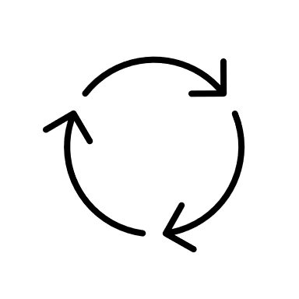
Process
Instruct
Assess
Access progress report
Evaluate next steps
Repeat
Notes:
The process for using instructionally embedded assessments always begins with instruction. Without instruction, assessment is groundless. Once the teacher determines adequate instruction has been provided, the student is assessed on the skills taught. Then, the teacher accesses a progress report that provides the assessment results, which the teacher uses to evaluate and determine the next steps for instruction and assessment. This process repeats throughout the assessment window.

Slide 6
Instruct Then Assess
Only assess a student after providing adequate instruction.
Instructionally embedded assessments are not to be used to establish a baseline.
Notes:
Again, the premise of instructionally embedded assessments is to focus on instruction first. Only assess a student after providing adequate instruction. The assessments are used to better understand what a student has learned and can do, then make additional instructional plans accordingly using the instructionally embedded assessments process. Instructionally embedded assessments are not to be used to establish a baseline.

Slide 7
Teacher Choice
Essential Elements
linkage levels
system-recommended level or a different level
Notes:
Instructionally embedded assessments are popular among teachers because they allow teachers to choose the Essential Elements to use for instructional planning and assessing. Teachers also choose the linkage level of each testlet a student takes. For each Essential Element, the system will initially recommend a linkage level based on the student’s submitted First Contact Survey, but a teacher can choose a different linkage level if desired. When in doubt, use the system-recommended level, and keep in mind the linkage level can be changed at any point before a testlet is assigned. Sometimes as instruction is implemented, a student may demonstrate a different skill level than expected. Therefore, adjusting the linkage level initially selected for the student would be appropriate.

Slide 8
Blueprints: Available Essential Elements
ELA and mathematics
claims and conceptual areas
Science
domains, core ideas, topics
Notes:
Remember that the Essential Elements available for assessment are listed on each state’s page of the DLM website in test blueprint documents for each subject. The blueprints for English language arts (ELA) and mathematics are organized into claims and conceptual areas, which are groups of related Essential Elements. The science blueprint organizes the Essential Elements by domains, core ideas, and topics. The organization of the Essential Elements in the blueprints is important in deciding how to construct units of lessons targeting multiple Essential Elements, as attempting to teach each Essential Element one at a time is not necessarily practical.
The ELA and mathematics blueprints for states using the Instructionally Embedded model of the assessment have selection criteria that apply to both assessment windows.

Slide 9
Helplet Video
Refer to “Using the Instruction and Assessment Planner” on the DLM website for step-by-step instructions.
Remember the Instruction and Assessment Planner is only available during an active assessment window.
Notes:
Essential Elements and linkage levels are chosen in the Instruction and Assessment Planner in Kite® Educator Portal. Refer to the helplet video “Using the Instruction and Assessment Planner” on the DLM website for step-by-step instructions. Remember the Instruction and Assessment Planner is only available during an active assessment window.

Slide 10
Educator Portal User Guide
Detailed instructions
Screenshots
Notes:
Detailed instructions for how to use the Instruction and Assessment Planner are also included in the Educator Portal User Guide. Step-by-step instructions are provided and include screenshots.

Slide 11
Choosing Multiple Essential Elements
Practical
plan units of lessons targeting multiple skills
teach conceptually for a class of students while addressing individual needs
Timely
assess each Essential Element and adjust linkage levels as needed
cover the blueprint more efficiently
Notes:
The Instruction and Assessment Planner conveniently displays the test blueprints for the student’s grade and subjects. Choosing more than one Essential Element in the Instruction and Assessment Planner at a time is both practical and timely. Teachers can use the organization of the Essential Elements in the test blueprints to plan units of lessons targeting multiple, complementary skills. Selecting multiple Essential Elements allows the teacher to teach conceptually for a class of students while addressing individual needs, even in multi-grade classrooms. Selecting multiple Essential Elements and adjusting the linkage levels for each student as appropriate also helps the teacher plan for how to cover the blueprint for all students more efficiently. Nevertheless, a teacher may decide to choose Essential Elements one at a time depending on the teacher’s approach to instruction, the number of students to be assessed, and other factors.

Slide 12
Strategies
Consider
class membership
academic goals of each student
time
Notes:
Strategies for approaching instruction and assessment will vary depending on class membership, the academic goals of each student, the time available to teach and assess, and many other factors. The more familiar a teacher becomes with the blueprints, the Essential Elements, and the mini-maps, the more ideas for providing creative and dynamic instruction will likely emerge.

Slide 13
Linkage Level Selection Status
Begin Instruction
Instruction in Progress
Instruction Complete Assign Testlet or Instruction Complete Do Not Assign Testlet
Testlet Assigned
Complete
Notes:
Selecting a linkage level card for an Essential Element in the Instruction and Assessment Planner and clicking the Begin Instruction button places the Essential Element and linkage level in the Instruction in Progress status. After instruction is provided, the teacher returns to the linkage level card and selects either Instruction Complete Assign Testlet or Instruction Complete Do Not Assign Testlet. Assigning a testlet means a testlet will be delivered to Kite Student Portal and cannot be undone. Instruction Complete Do Not Assign Testlet is selected when deciding to change the student’s linkage level based on classroom performance during instruction. A different linkage level or even a different Essential Element can be selected instead, and the selection process would start over. Once a student takes a testlet in Student Portal, the linkage level for the testlet taken will display as Complete.

Slide 14
Mini-Maps
Useful in determining the skills to be taught and how to help a student progress
Available in the Instruction and Assessment Planner on each linkage level card
Notes:
Mini-maps are vital resources for the DLM alternate assessment because they are useful in determining the skills a student already has related to an Essential Element and the skills the student could be taught to help the student progress. The Essential Element’s mini-map is available in the Instruction and Assessment Planner as a PDF on each linkage level card.

Slide 15
Suggestion
Use the DLM website to become familiar with the test blueprints and mini-maps until the assessment window starts and the Instruction and Assessment Planner becomes available.
The mini-maps are in the Currently Tested Essential Elements resources, not the blueprints.
Notes:
The test blueprints and the mini-maps are always accessible on the DLM website. The Instruction and Assessment Planner is only available during an active window. Therefore, use the DLM website to become familiar with the test blueprints and mini-maps until the assessment window starts and the Instruction and Assessment Planner becomes available. The test blueprints do not contain linkage level information. The mini-maps, which display the linkage level skills, are in the Currently Tested Essential Elements resources. Thoughtful use of the blueprints and the mini-maps leading up to an assessment window will help make selecting Essential Elements and linkage levels in the Instruction and Assessment Planner an easy and efficient process.
The website also includes several instructional resources, such as familiar texts for ELA, a mathematics glossary, and instructional activities for science, among others.

Slide 16
Fall and Spring Performance Reports
Notes:
Teachers in states using the Instructionally Embedded model of the assessment will have access to both a Fall Performance Report and a Spring Performance Report in the Instruction and Assessment Planner. These reports provide the number of blueprint requirements met, the number of plans with instruction in progress, the number of testlets assigned and ready to assess, and the total number of testlets completed.

Slide 17
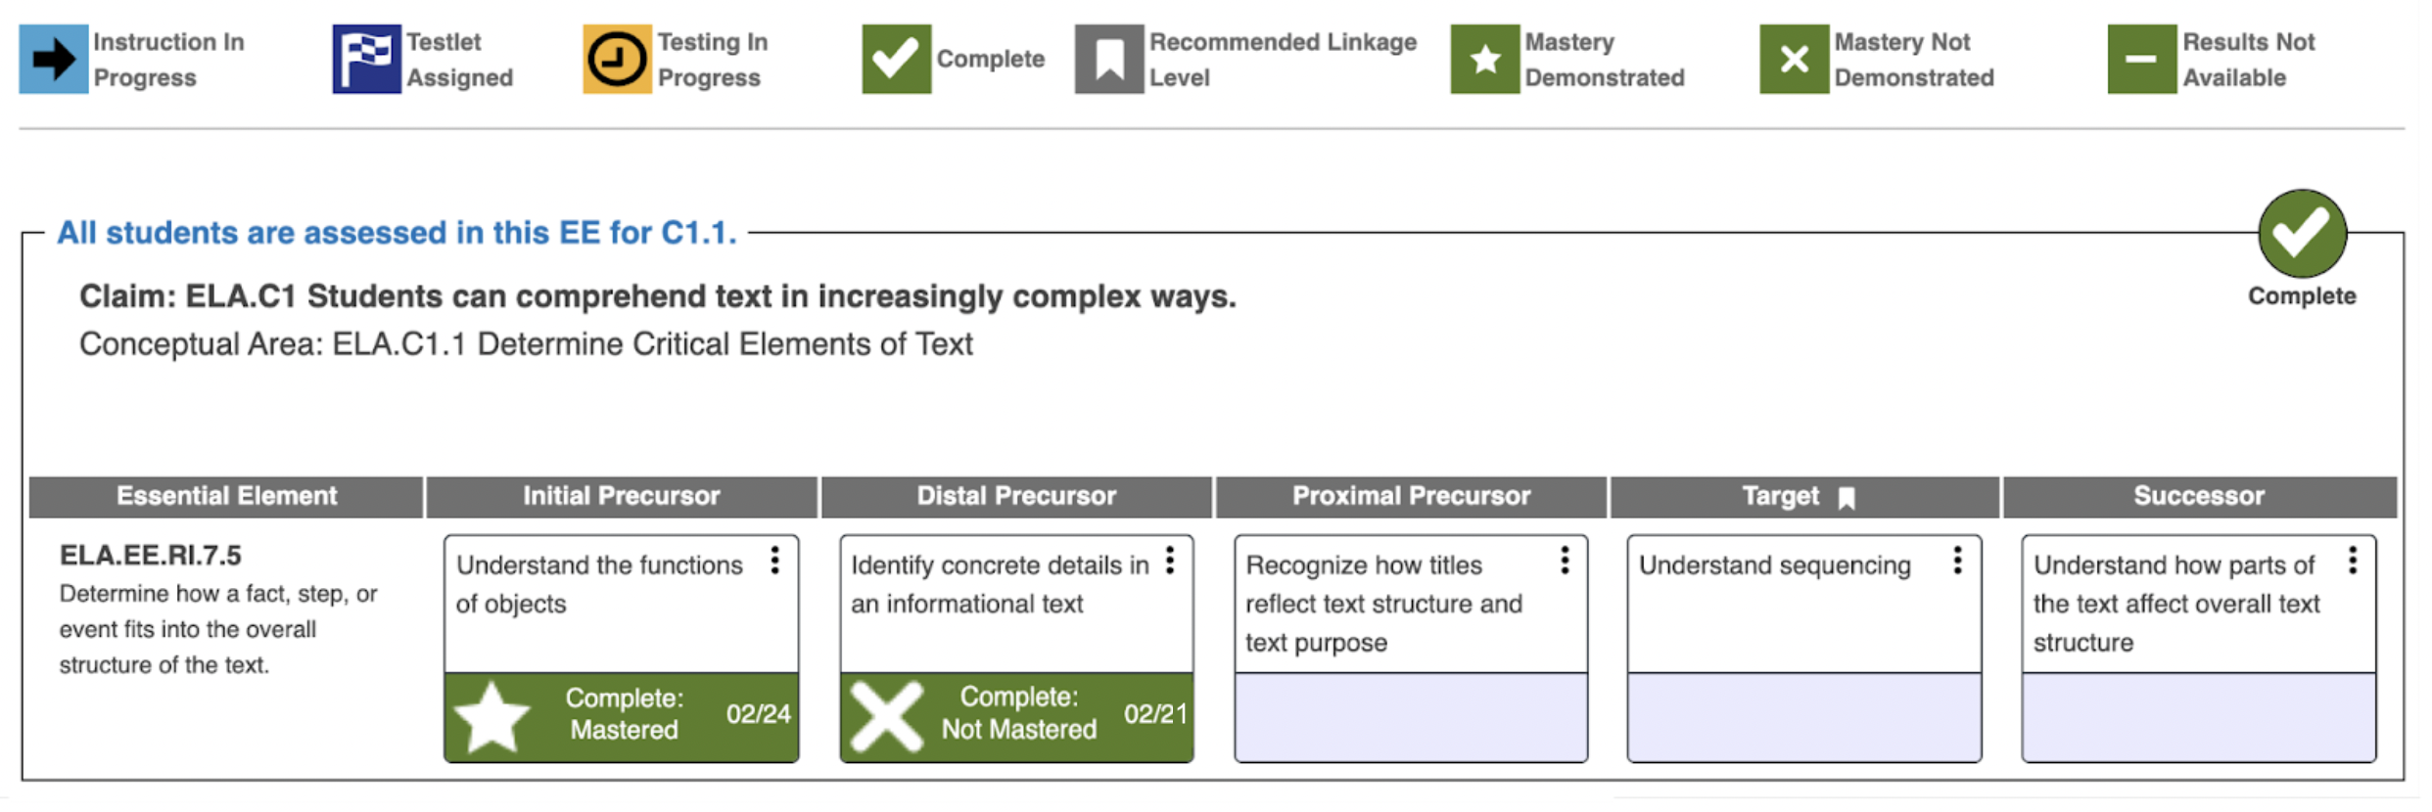
Icons
Notes:
Icons are used in the Instruction and Assessment Planner to indicate the status and results of instructionally embedded testlets taken.
A star or an X will appear on any linkage level for which the student completed a testlet. A star indicates the student demonstrated mastery of the linkage level, and an X indicates the student did not master the linkage level.
A minus symbol is used to indicate testlets for which results are not available. The minus symbol will appear for instructionally embedded writing testlets because writing testlets must be scored outside the assessment system.
A checkmark indicates when the blueprint requirements for each claim or conceptual area are met.

Slide 18
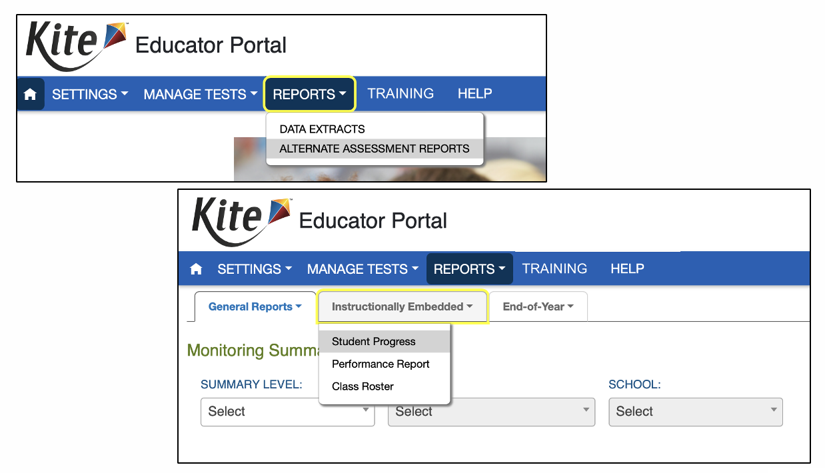
Student Progress Reports
Notes:
A Student Progress report is updated each time a student takes an instructionally embedded assessment. Student Progress reports show the Essential Elements and linkage levels on which a student has taken testlets and whether the student mastered the linkage level skills. A student’s Progress Report is accessed in Educator Portal. Select the REPORTS tab, then ALTERNATE ASSESSMENT REPORTS, then Instructionally Embedded, and finally Student Progress. Reports for the class roster are also available.

Slide 19
Evaluating Next Steps
Use reports to determine whether to provide continued instruction on the linkage level then reassess the student or
select a different linkage level
select a different Essential Element
A student can be reassessed on the same Essential Element but will not receive the same testlet twice.
The pool of testlets for each linkage level is limited.
Notes:
Teachers should use the reports to determine whether to provide continued instruction on the linkage level assessed and then reassess the student or select a different linkage level or even a different Essential Element. A student can be reassessed on the same Essential Element and linkage level but will not receive the same testlet twice. Be aware that the pool of testlets for each linkage level is somewhat limited. If a student is struggling to show mastery on the intended linkage level skills, consider a lower linkage level. Teaching and assessing the student at a lower linkage level skill might help the student progress to the intended linkage level. However, be careful not to limit a student to the lower linkage levels, because students deserve the opportunity to learn as many skills as possible and demonstrate what they know and can do through the assessment. The assessment window timespan is often the teacher’s determining factor as to whether the student should be reassessed at the same linkage level or if moving on to a different skill is more constructive.

Slide 20
Not Necessary
Assessing a student repeatedly until mastery of the linkage level is achieved
Assessing the student at every linkage level for every Essential Element
Assessing every student on the same Essential Elements and linkage levels
Notes:
Assessing a student repeatedly until mastery of the linkage level is achieved is not necessary, nor is assessing the student at every linkage level for every Essential Element or assessing every student on the same Essential Elements and linkage levels. While choosing Essential Elements for instructional units of lessons for a class of students is advised, adjustments will likely be necessary from student to student, and the instructionally embedded assessments should still be considered individualized for each student’s academic needs and goals.

Slide 21
Continue the Cycle
Instruct
Assess
Access progress report
Evaluate next steps
Repeat
Notes:
The process of instructing, assessing, accessing reports, and evaluating the next steps should be repeated for each student throughout the assessment window.

Slide 22
Reminder for States Using the Instructionally Embedded Model (1)
For states that assess science
Assessing science in the fall is optional
The science assessment is not instructionally embedded for the required spring window.
The system assigns all spring science testlets.
Students take a testlet for every Essential Element listed on the blueprint for their grade band.
Notes:
Finally, as a reminder for states that use the Instructionally Embedded model of the assessment and that assess science, assessing science in the fall window is recommended but optional. For the spring window, assessing science is required but not instructionally embedded. The system assigns all spring science testlets. Students take a testlet for every Essential Element listed on the blueprint for their grade band.

Slide 23
Reminder for States Using the Instructionally Embedded Model (2)
ELA and mathematics blueprints have sets of requirements that apply to both assessment windows.
Different Essential Elements can be chosen for the spring than were chosen for the fall, but continue to follow the blueprint coverage criteria.
Notes:
Also, for teachers in states using the Instructionally Embedded model of the assessment, the ELA and mathematics blueprints have sets of requirements that need to be met for both assessment windows. Different Essential Elements can be chosen for the spring than were chosen for the fall, if desired, but continue to follow the blueprint coverage criteria in the blueprints. The criteria is also included in the Instruction and Assessment Planner.

Slide 24
Reminder for States Using the Year-End Model
Use of instructionally embedded assessments
is completely optional
is only used during the Year-End model’s instructionally embedded window during the fall/winter months
does not affect a student’s end-of year score report
does not replace any assessments delivered for the Year-End spring assessment window
Notes:
As a reminder for states using the Year-End Model of the assessment, use of instructionally embedded assessments is completely optional, is only used during the Year-End model’s instructionally embedded window, does not affect a student’s end-of-year score report, and does not replace any assessments delivered and required during the Year-End spring assessment window.

Slide 25
Resources
Using the Instruction and Assessment Planner (video)
Educator Portal User Guide
Notes:
Again, be sure to watch the video “Using the Instruction and Assessment Planner” and read the Educator Portal User Guide for detailed information about instructionally embedded assessments.
This concludes the presentation.

