Slide 1

Spring 2026 Dynamic Learning Maps® (DLM®) Alternate Assessment for Maryland Test Coordinators’ Training

Slide 2
Topics (1)
Maryland DLM Assessment Window Dates for 2025–2026
Updates to Kite® Suite applications
DLM Assessment roles and resources
DLM Required Test Administrator Training Updates

Slide 3
Topics (2)
Assessment design and delivery
Necessary steps for a student to be assessed
Monitoring the assessment
Contacting the DLM Service Desk
Allowable personally identifiable information (PII) sharing

Slide 4

Maryland Spring 2026 DLM Assessment Window
March 9, 2026–May 15, 2026
Data cleanup before and during the window
Testlets available when the assessment window opens

Slide 5
Subjects and Grades Assessed
Grade | ELA | Mathematics | Science
3 | Yes | Yes | No
4 | Yes | Yes | No
5 | Yes | Yes | Yes
6 | Yes | Yes | No
7 | Yes | Yes | No
8 | Yes | Yes | Yes
9, 10 | No | No | No
11 | Yes | Yes | Yes (Biology)
12 | Optional | Optional | Optional

Slide 6
Kite Suite Updates

Slide 7
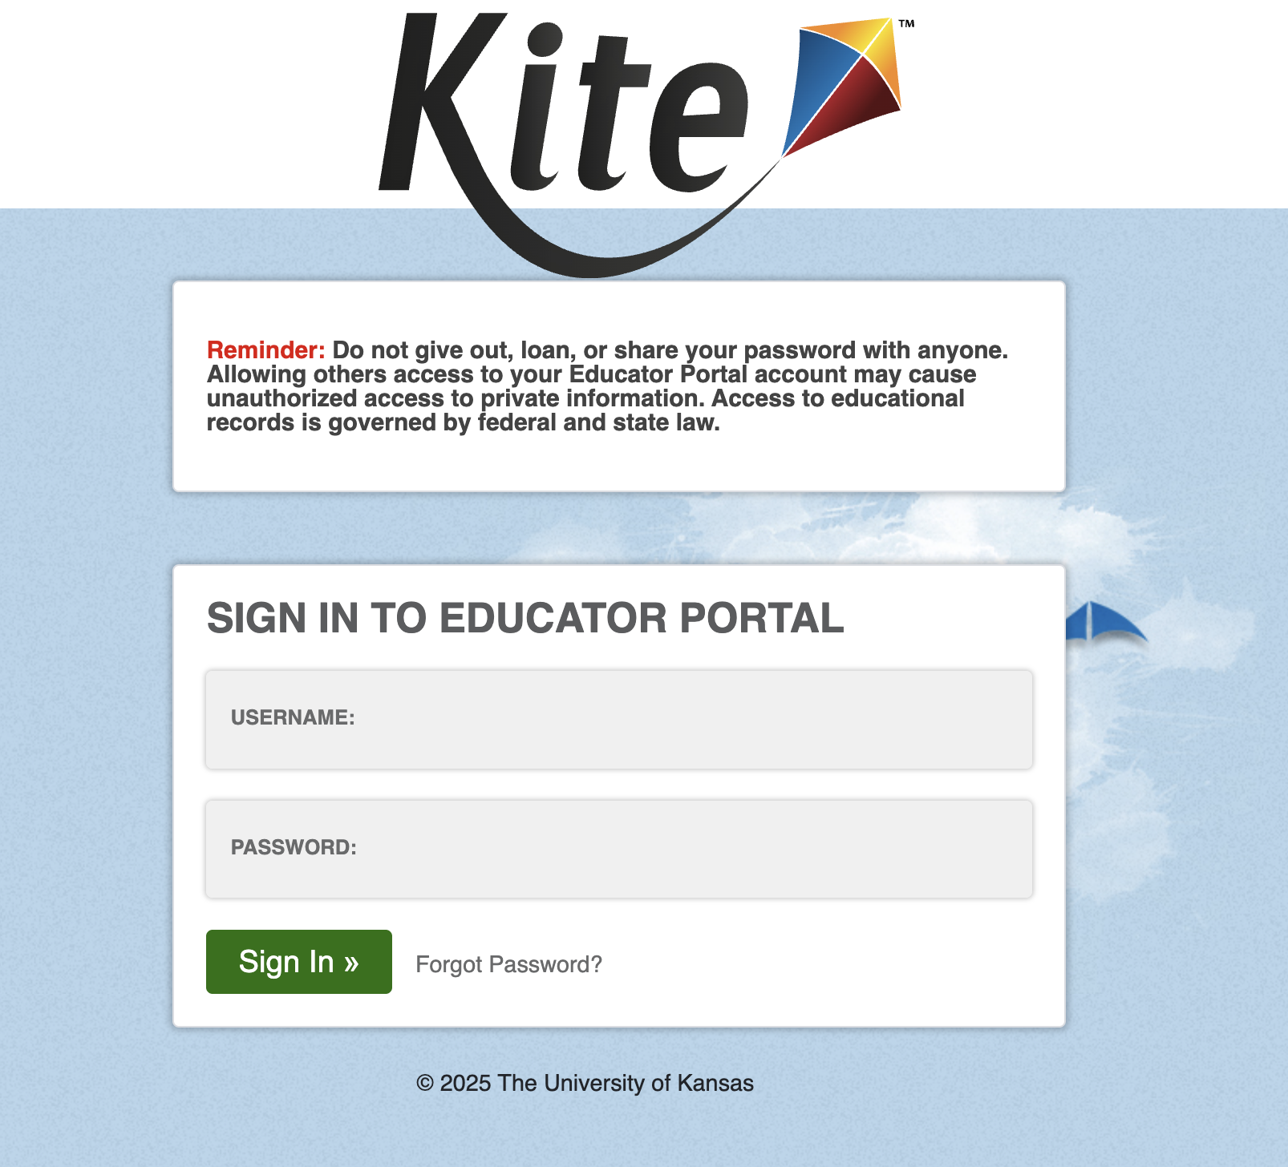
Educator Portal Multifactor Authentication (MFA)(1)
Enter valid username and password.
Select Sign In.
System sends an MFA access code via email.

Slide 8
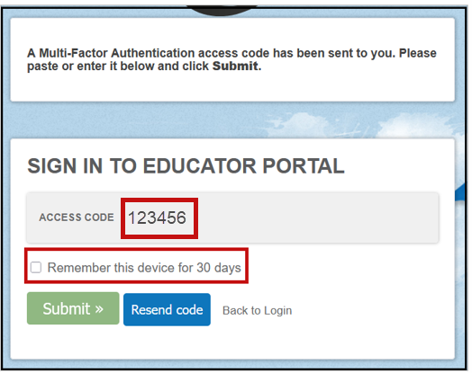
Educator Portal Multifactor Authentication (2)
Enter the access code.
Select the checkbox for remembering the code on this device for 30 days (optional).
Select Submit.
User is logged in to the system.

Slide 9
Educator Portal Multifactor Authentication (3)
If cookies are cleared from the web browser, Educator Portal will require the access code to be entered again even if the option to remember the device for 30 days was selected.
Review the Educator Portal announcement from September 26, 2025.

Slide 10
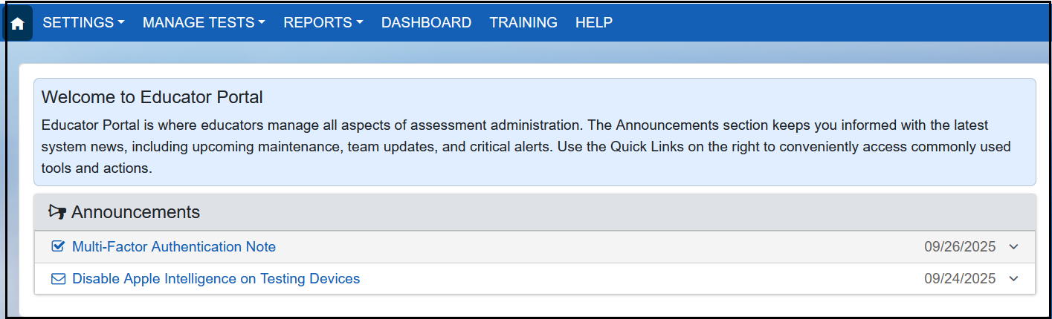
Educator Portal Home Page Update

Slide 11
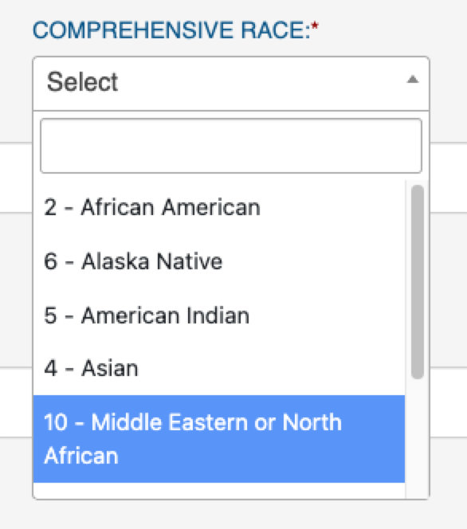
New Value Added to Comprehensive Race in Student Enrollment
The following value has been added to the Comprehensive Race options in student enrollment:
10 = Middle Eastern or North African

Slide 12
New Error Message To Help Prevent Duplicate Student Enrollments (1)
When uploading students using the Enrollment Upload Template file, the enrollment record was flagged if another student had matching first name, last name, gender, and date of birth but a different SSID.
Although an alert message was generated, a duplicate student record was still created.

Slide 13
New Error Message To Help Prevent Duplicate Student Enrollments (2)
A new error message is now generated to help prevent duplicate enrollments.
Review the records and make any needed edits.

Slide 14
New Error Message To Help Prevent Duplicate Student Enrollments (3)
Error message
A student record for the current or a previous school year already exists in your state with a matching first name, last name, gender, and date of birth, but a different State Student Identifier. Contact your State Assessment Administrator for help in correcting the data.

Slide 15
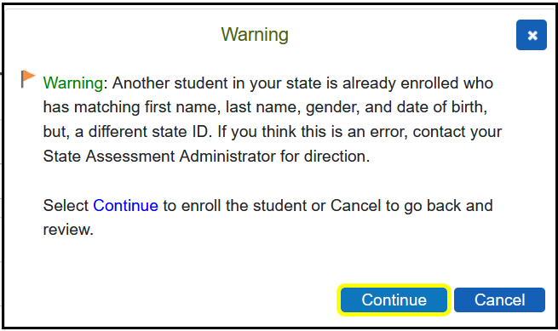
New Error Message To Help Prevent Duplicate Student Enrollments (4)
A duplicate enrollment can still occur when using the user interface.

Slide 16
Extract and Upload Template Headers Labels and Order
Goals
Consistent column headers and order for upload template files
Consistent field names across extracts (when applicable)
Consistent column order (when applicable)
Be sure to use only the upload templates for 2025–2026.

Slide 17
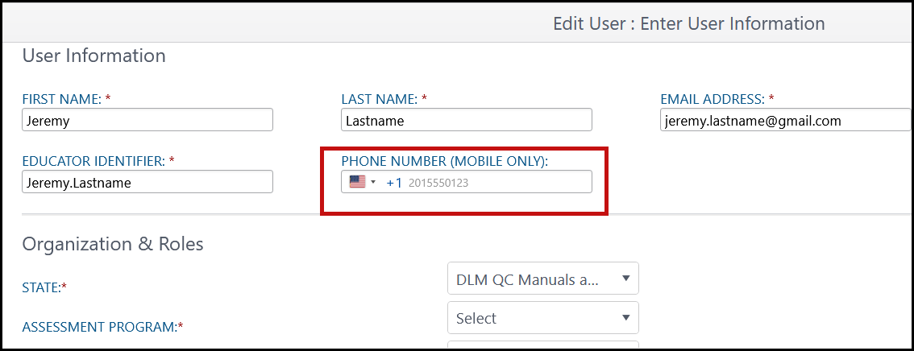
New Phone Number Field in Add/Edit User
Available Now
Looking Ahead
Option for users to receive MFA access code on their cell phone via SMS will be implemented in a future year. Users can continue with email.

Slide 18
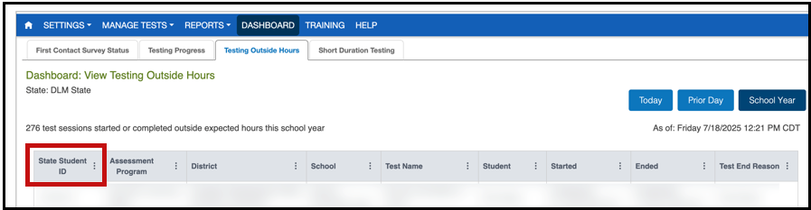
State Student ID Added to Testing Outside Hours Dashboard

Slide 19
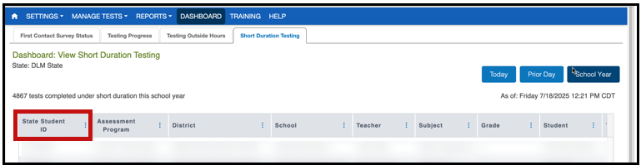
State Student ID Added to Short Duration Testing Dashboard

Slide 20
New Options for Special Circumstance Codes
If a Maryland student cannot test for an approved reason, the student can have a special circumstance code applied to their record at the student, subject, or test session level.
Your State Assessment Administrator must approve the reason, and only they can apply the code.

Slide 21
Science

Slide 22
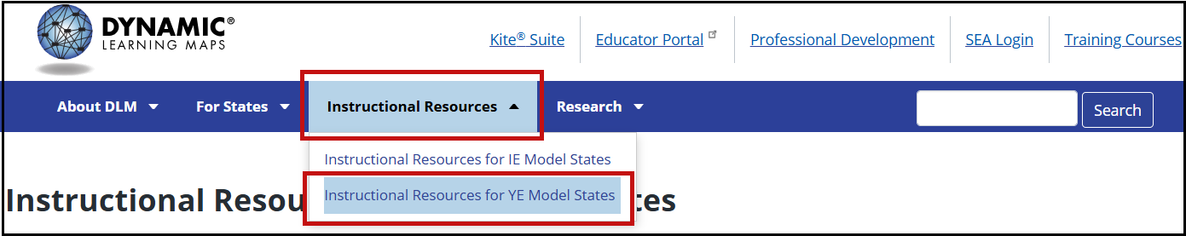
Important Notice for Science (1)
Go to the Instructional Resources tab and select Instructional Resources for Year-End Model States.

Slide 23
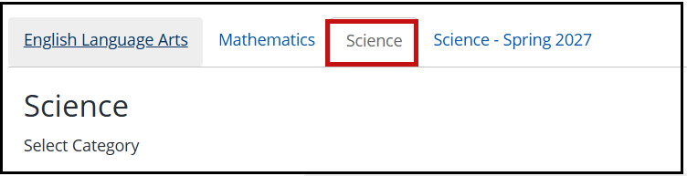
Important Notice for Science (2)
Two science tabs are included to help with this transition.

Slide 24
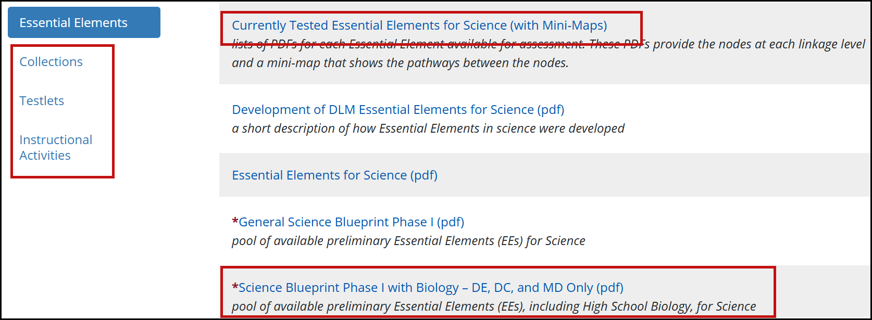
Important Notice for Science (3)

Slide 25
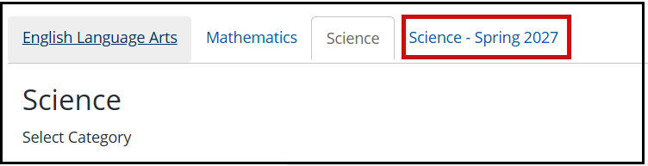
Important Notice for Science (4)
Go to the Science - Spring 2027 tab.

Slide 26
Important Notice for Science (5)
Embedded Science Field Test Testlets Spring 2026
All students, all grade bands
Four science field test testlets per student
Delivered in two sets of two testlets each
Available at the opening of the window
Can be taken any time during the window

Slide 27
Important Notice for Science (6)
Field tests will have four linkage levels:
Initial Precursor
Distal Precursor
Proximal Precursor
Target

Slide 28
Required Test Administrator training

Slide 29
DLM Required Test Administrator Training Modules (1)
Open Date: August 5, 2025
Close Date: May 15, 2026
Access: Test administrators need an Educator Portal account to access and complete the training. The required training link is found in Educator Portal on the Training tab on the home screen.

Slide 30
DLM Required Test Administrator Training Modules (2)
Users | Required Modules
New Teachers | 4
Returning Teachers | 1*
*If the module is not passed on the first attempt, the returning teacher is directed to additional required training.

Slide 31
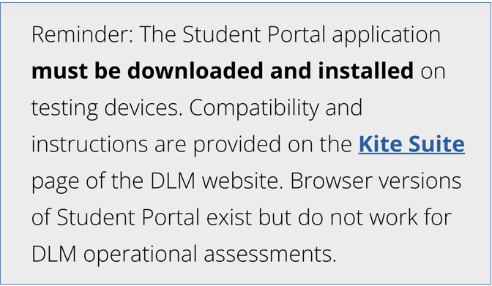
DLM Required Test Administrator Training Modules (3)

Slide 32
Locating DLM Resources

Slide 33
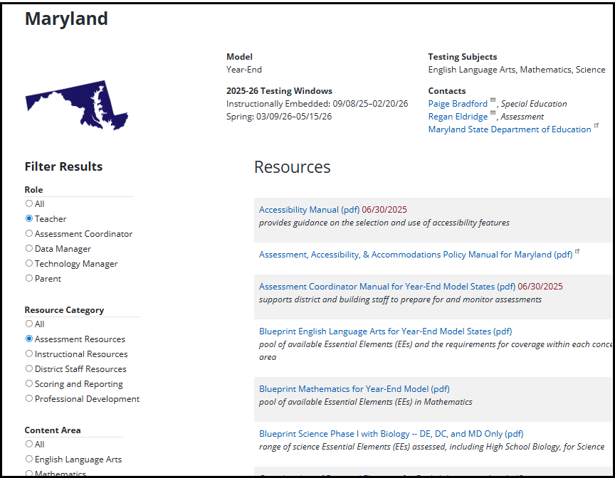
Locating Maryland Resources on the DLM Website
All DLM resources can be found on Maryland’s DLM webpage.
https://dynamiclearningmaps.org/maryland

Slide 34
Resources for Teachers on the DLM Website
Manuals and guides
Test Administration Manual
Accessibility Manual
Educator Portal User Guide
Guide to DLM Required Test Administrator Training
Instructional resources
Helplet videos
Released Testlets and Practice Activities

Slide 35
Resources for Technology Personnel on the DLM Website
Manuals
Kite Suite Technology Requirements
Technology Specifications Manual
Kite Suite link (https://dynamiclearningmaps.org/kite)
Kite system status
Supported platforms and installation instructions
Troubleshooting Kite upload errors

Slide 36
Resources for Test (Assessment) Coordinators on the DLM Website
Manuals and guides
Assessment Coordinator Manual
Accessibility Manual
Test Administration Manual

Slide 37
Resources for Data Managers on the DLM Website
Manuals and guides
Data Management Manual
Educator Portal User Guide
Templates
State Organizational Table
Upload templates

Slide 38
Additional Training
DLM Training for District Roles
Short, interactive lessons for assessment coordinators, data managers, technology managers, and district and building administrators

Slide 39
Assessment design

Slide 40
Standards: Essential Elements
Are the learning targets for the DLM assessments
Align to Maryland’s grade-level standards
Provide a bridge from grade-level content standards to academic expectations for students with the most significant cognitive disabilities

Slide 41
Linkage Levels (1)
Provide levels of complexity for each Essential Element
ELA and mathematics each have five linkage levels.
Science has three linkage levels for operational testlets in spring 2026.
Science has four linkage levels for field test testlets in spring 2026.

Slide 42
Linkage Levels (2)
Designed so that academic content is accessible to the individual student—not too hard nor too easy
Used to assess the skills and knowledge in a testlet
Each testlet is aligned to one linkage level (except writing testlets, which combine Essential Elements and linkage levels).
The DLM system assigns the linkage level for each student based on the student’s First Contact Survey.

Slide 43
Linkage Levels for ELA and Mathematics
Linkage levels | Complexity
Initial Precursor | Least complex; foundational
Distal Precursor | Knowledge and skills needed to reach the target
Proximal Precursor | Provides access to the Target
Target | Aligns to content of the Essential Element
Successor | Progresses beyond the Target

Slide 44
Linkage Levels for Spring 2026 Science
Linkage levels | Complexity
Initial | Least complex
Precursor | More complex
Target | Most complex and aligns with Essential Element

Slide 45
Linkage Levels for Spring 2026 Science Field Tests
Linkage levels | Complexity
Initial Precursor | Least complex
Distal Precursor | Knowledge and skills needed to reach the target
Proximal Precursor | Provides access to the Target
Target | Aligns to content of the Essential Element

Slide 46
Assessment delivery

Slide 47
Remote Testing
Remote testing is not permitted for the DLM assessment.
DLM assessments can only be administered in a secure testing environment.

Slide 48
Data Manager Responsibilities for Assessment Delivery
To gather, edit, and upload data in Educator Portal for
users: educators, test administrators, and staff
enrollment: students
rosters: assigning students to educators
Typically has the District Test Coordinator or Building Test Coordinator role in Educator Portal

Slide 49
Teacher Responsibilities to Administer the Assessment (1)
New teachers must activate their Educator Portal account using the activation email.
All teachers must complete the security agreement in Educator Portal.
The test administrator who administers the testlets must be the one to whom the student is rostered.

Slide 50
Teacher Responsibilities to Administer the Assessment (2)
Complete Required Test Administrator Training.
Complete each student’s Personal Learning Profile (First Contact Survey and Personal Needs and Preferences [PNP] Profile in Educator Portal).
Plan and deliver assessments to students in Student Portal.

Slide 51
Personal Learning Profile
First Contact Survey = determines the linkage level of a student’s first testlet in each subject in the spring assessment window
PNP Profile = accessibility support features the student will need during the assessment

Slide 52
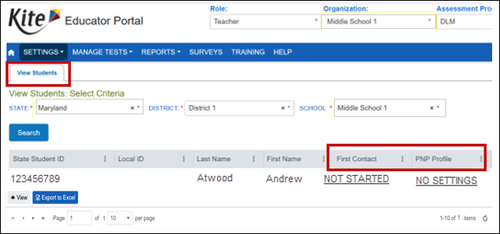
View Student Screen

Slide 53
First Contact Survey
Information in the First Contact Survey is used to determine the linkage level of a student’s first testlet.
Subsequent testlets are assigned based on student performance on the previous testlet.

Slide 54
PNP Profile
Informs the system which accessibility support features the student needs
Display Enhancements
Language & Braille
Audio & Environment
Other Supports

Slide 55
Completing the First Contact Survey and PNP Profile
For more information, watch the helplet titled Completing the First Contact Survey and PNP Profile.
Educator Resource Videos for Year-End Model States link on DLM webpage

Slide 56
DLM Testlet Overview
Delivered over a period of several weeks
Individualized experience for students
Engagement activity at the beginning of the testlet followed by test items
Testlets are delivered in Student Portal to rostered students with a submitted First Contact Survey when the assessment window opens.

Slide 57
Administering ELA and Mathematics Testlets
The number of testlets varies by grade and subject.
Nine for ELA, including writing
6–8 for mathematics
Begins with an engagement activity followed by items
3–9 conceptually related items

Slide 58
Administering DLM Science Testlets
9–10 testlets per student
10 testlets for high school biology
3–5 multiple-choice items per testlet
Each testlet begins with an engagement activity.

Slide 59
Testlet Information Page (TIP)
TIPs provide test administrators with information specific to each testlet, including
if the testlet is computer-delivered or teacher-administered
materials needed and how they can be used
Test administrators must download TIPs prior to assessing students.
View the first five minutes of Overview of DLM English Language Arts Testlets.

Slide 60
The Importance of Testlet Engagement Activities
Activates prior knowledge
Motivates students
Provides context to test items
View Overview of DLM English Language Arts Testlets
Begin at 5 minutes and 15 seconds

Slide 61
Writing Samples
Only the student’s test administrator can upload writing samples in Educator Portal.
A direct link is available only to the rostered test administrator.
Test administrators are required to scan and upload each student’s writing sample.
State policy determines where and for how long writing samples are stored after the testing window closes.

Slide 62
Annual Teacher Surveys (1)
Collects evidence on the quality of the assessment system
Gathers feedback on teacher and student experiences
Evaluates statements in the DLM validity argument
Provides technical evidence needed for federal peer review submissions
Informs programmatic improvements

Slide 63
Annual Teacher Surveys (2)
Associated with a student’s SSID
Should be completed after student testing is complete
Must be submitted before the spring window closes
Are required for at least one student

Slide 64
Data Verification and Revisions
Test coordinators should verify the accuracy of data and make changes as necessary.
Data changes can be made any time before or during the assessment window.
Refer to the Data Management Manual when monitoring data.

Slide 65
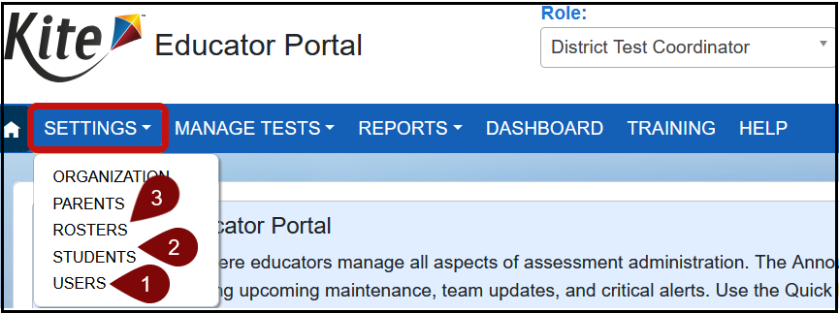
Where to Complete Data Management Tasks
To manage data, select Settings on the Educator Portal homepage. From the available options, select
Users
Students
Rosters

Slide 66
Monitoring the Assessment

Slide 67
Extracts (1)
Available in Educator Portal to help monitor the assessment.
Under the Reports tab
Based on user role
District users = district-level extracts
Building users = building-level extracts
Teachers = student and class extracts
Provided in .CSV format

Slide 68
Extracts, Reports, and the Dashboard
15 extracts are available to help monitor preparedness for the assessment and testing progress during the assessment window.
Several reports are available, such as the Student Progress report.
The Dashboard can provide percentages toward blueprint completion and other helpful information.

Slide 69
Short Duration Testing
The timespan displays Hour: Minutes: Seconds 00:00:00 for each subject and is updated twice daily.
The minimum number of seconds for each subject is
ELA: 60 seconds
Mathematics: 30 seconds
Science: 30 seconds
A test session will appear on the Short Duration Testing report if the duration is the same or shorter than the minimum number of seconds.

Slide 70
Extracts (2)
Use the Student Roster and First Contact Survey Status extract to monitor whether students are rostered correctly and when the First Contact Survey was completed.
Use the DLM Test Administration Monitoring extract to monitor testing progress.
Use the TIP Access extract to ensure the TIPs are being accessed.

Slide 71
Educator Portal Dashboard
District Test Coordinators have access to dashboard reports.
Select Dashboard on the Educator Portal home screen.
First Contact Survey Status
Testing Progress
Testing Outside Hours
Short Duration Testing

Slide 72
DLM Service Desk Contact Information
Phone: 855-277-9751 (toll-free)
Email: DLM-support@ku.edu
Live Chat in Educator Portal
Testing environment issues
Test administration issues
User account issues
Student information issues

Slide 73
Protect Student Data Privacy
Please do not violate the Family Educational Rights and Privacy Act (FERPA).
Call the DLM Service Desk if you need to provide any identifying student information.
Email or Live Chat only the state student identification number.

Slide 74
Thank You!

