Slide 1
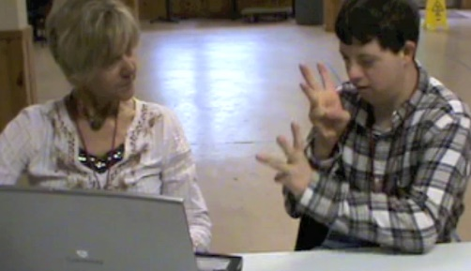
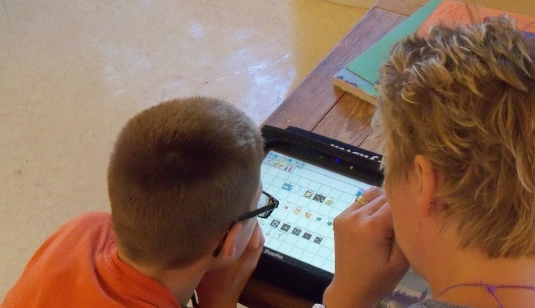
Dynamic Learning Maps® (DLM®) Spring 2025 Assessments for District of Columbia Test Coordinators
© 2025 Accessible Teaching, Learning, and Assessment Systems (ATLAS), the University of Kansas

Slide 2
Spring 2025 DLM Assessment Window
Required spring window:
March 10, 2025 – April 25, 2025
Eligible science students in grades 5, 8, and high school biology.

Slide 3
Important Information (1)
The Test Security Agreement must be completed each school year.
Required Test Administrator Training must be completed by new and returning teachers.
The student will be enrolled by OSSE or the LEA depending on grade.

Slide 4
Important Information (2)
The student will be rostered by OSSE to available teacher accounts.
The student’s First Contact survey must be completed by the teacher.
The student’s Personal Needs and Preferences profile will be completed by the teacher if needed.

Slide 5
Kite Suite Updates

Slide 6
Show Students Not Rostered to a Subject (1)
New ‘Only show students who are NOT rostered to this subject’ checkbox in UI when creating or editing a roster

Slide 7
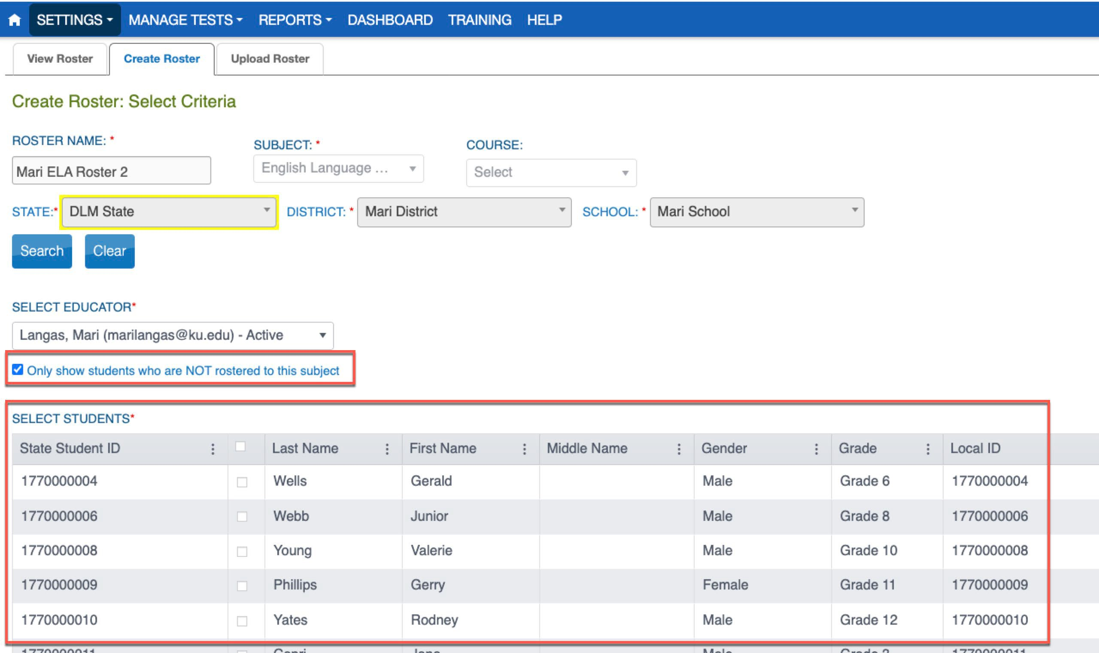
Show Students Not Rostered to a Subject (2)
When selected, Students grid will only show students who are not already rostered to the subject
Also available when editing a roster

Slide 8
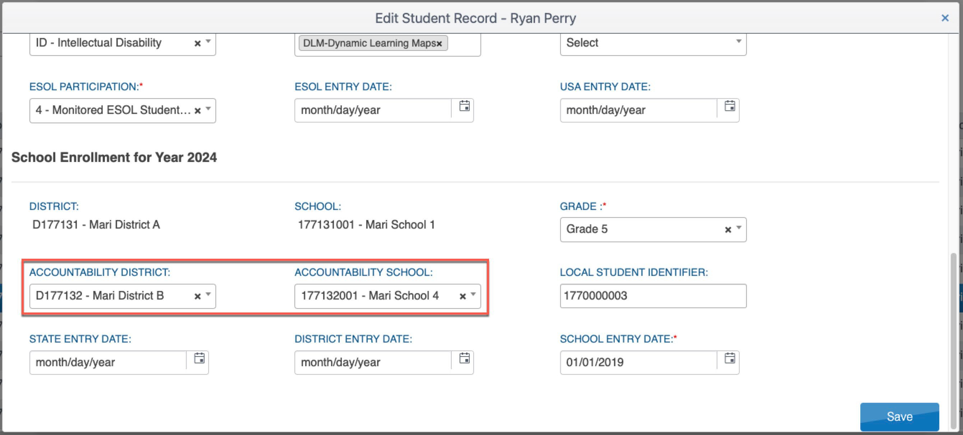
Edit Accountability District and School via UI

Slide 9
TEC Upload Template Updates
Attendance_School_Program_Identifier column has been renamed to be Attendance_School_Identifier and reorder
8

Slide 10
Remove Roles from Users (1)
Currently in the UI, users can remove roles from one user at a time.
Feedback: Need to remove one or more roles from one or more users at a time
Update: New ‘Remove_Role’ column added to the User Upload Template
9

Slide 11
Remove Roles from Users (2)
User template upload: If Remove_Role = True, then the role listed under the “Primary_Role” column will be removed from the user account

Slide 12
User Extract Updates
Educator_Identifier column moved before the user’s first and last name columns to make it easier to copy over educator information to roster upload template

Slide 13
TIP Access Extract Updates
Teacher surveys will no longer be included
Will include all users who have accessed the TIP
Example:

Slide 14
Enrollment Extract and Enrollment Upload Template Update
Currently:
Column O in the enrollment extract = “Current Grade Level”
Column N in the enrollment upload template = “Current Grade Level”
Update:
Column O in the enrollment extract = “Grade”
Column N in the enrollment upload template = “Grade”

Slide 15
Training Status Extract: Complete Date
New ‘RTComplete_Date’ column: Date the user completed required test administrator training

Slide 16
Educator Portal Dashboard (1)
State opt-in to allow District Test Coordinator access to dashboard reports:
First Contact Survey Status
Testing Outside Hours
Short Duration Testing

Slide 17
Educator Portal Dashboard (2)
State opt-in to allow District Test Coordinator access to dashboard reports:
First Contact Survey Status
Testing Outside Hours
Short Duration Testing

Slide 18
New Student Login Usernames/Passwords Extract (1)
New extract that includes student usernames and passwords

Slide 19
New Student Login Usernames/Passwords Extract (2)
Available to:
State Assessment Administrators
District Test Coordinators
Building Test Coordinators
Teachers
Available once Required Test Administrator Training is passed

Slide 20
Kite® Clients
Kite® Client v11.0 will be used in 2024–2025.
Android client is now available.
– If you plan to use Android tablets for the 2024–2025 school year, please contact the DLM Service Desk to discuss this compatibility.

Slide 21
Required Test Administrator Training

Slide 22
Required Test Administrator Training Modules (1)
Open Date: December 12, 2025
Close Date: April 25, 2025
Access: Test Administrators need an Educator Portal account to access and complete the training. The required training link is found on the Training tab on the home screen.

Slide 23
Required Test Administrator Training Modules (2)
Returning teachers: One self-directed module with one opportunity to pass. If the module is not passed, the teacher is directed to additional required training.
New teachers: Four modules, plus an additional First Contact survey and PNP Profile training video

Slide 24
DLM Roles & Resources

Slide 25
Locating District of Columbia Resources on the DLM Website
All DLM resources can be found on DC’s DLM webpage
Use filtering options on the left panel to locate related documents faster
Links to DLM Professional Development website and scoring and reporting documents

Slide 26
Resources for Teachers on the DLM Website
District of Columbia DLM webpage—Teacher filter
Manuals
Test Administration Manual for Science
Accessibility Manual for Science
Educator Portal User Guide
Educator Resource Page
Test blueprints and Currently Tested Essential Elements
Helplet videos
Released Testlets and Practice Activities
Professional development modules

Slide 27
Resources for Technology Personnel on the DLM Website
District of Columbia DLM webpage—Technology Manager filter
Manuals
Kite Suite Technology Requirements
Technology specifications manual
Kite Suite link
Kite system status
Supported platforms
Installation instructions
Troubleshooting Kite upload errors

Slide 28
Resources for Test (Assessment) Coordinators on the DLM Website
District of Columbia DLM webpage—Assessment Coordinator filter
Manuals
Assessment Coordinator Manual for science
Accessibility Manual for Science
Guide to DLM Required Test Administrator Training
Test Administration Manual for Science
Educator Portal User Guide

Slide 29
Resources for Data Managers on the DLM Website
District of Columbia DLM webpage—Data Manager filter
Manuals
Data Management Manual
Educator Portal User Guide
Templates
State Organizational Table
Upload Templates

Slide 30
Additional Training
DLM Training for District Roles
short, interactive lessons for assessment coordinators, data managers, technology managers, and district and building administrators

Slide 31
Managing Data in Educator Portal

Slide 32
Data Verification and Revisions
Data cleanup is the responsibility of all users.
Test coordinators should verify accuracy of data and make changes as necessary.
Data changes can be made anytime before or during the assessment window.

Slide 33
Where to Complete Data Management Tasks

Slide 34
Managing User Account Data (1)
New users need to be added manually or by using a file upload.
Educator Portal sends an activation email to the new user with a link to create a password.
The user’s email address is the unique account key.

Slide 35
Managing User Account Data (2)
Users may have more than one role in Educator Portal.
Users are rolled over from the year before.
Deactivation of user accounts may be done manually or by using the user upload template.

Slide 36
Add User Accounts
Add User: manually add a few users
Upload Users: add users with an upload template

Slide 37
Edit User Accounts
Common changes for users include
organization assignment
email address
add or remove roles
Manually edit when a few users need changes.
Use the upload template when more than a few users need changes.
Updated information only affects users in the upload.

Slide 38
Resending the Account Activation Email to Users
The most common reasons the Kite activation email would need to be resent
A user did not receive the email or accidentally deleted the email.
The user did not activate the account within 20 days of receiving the email.

Slide 39
Adding Students
All students required to take the DLM assessment in 2025 need to be added to Educator Portal
Students can be added using the Educator Portal user interface or by using an upload template.

Slide 40
Edit a Student
Manually edit when a few students need changes.
Use the upload template when more than a few students need changes.
The upload will only update information for students in the upload.

Slide 41
Exit a Student
A student must be exited from Educator Portal when the student is
leaving District of Columbia, leaving the LEA with an unknown destination, or is no longer taking the DLM alternate assessment
Exiting is not applicable to students who are remote and cannot test.
Exits can be done manually or using the Test, Exit, Clear (TEC) upload.

Slide 42
Rostering (1)
Rosters connect a student to a teacher in Educator Portal.
New students can be added to an existing roster.
The teacher on a roster can be changed.

Slide 43
Rostering (2)

Slide 44
Rostering (3)
Rostering for high school biology
select biology as the course.

Slide 45
Administration of DLM Science Testlets

Slide 46
Time Commitment for the Administration of DLM Science Testlets
9 -10 testlets per student
Each testlet assesses ONE of the Currently Tested Essential Elements for Science
3 – 5 multiple-choice items per testlet
Each testlet begins with an engagement activity
5 – 15 minutes per testlet
The total administration time needed is approximately 45–135 minutes

Slide 47
DLM Science Essential Elements
Science Essential Elements have three linkage levels: Initial, Precursor, and Target
DLM science testlets are written by linkage level
Each testlet assesses one Essential Element at one linkage level

Slide 48
Engagement Activities for Science Testlets
Short setup: Read once.
Longer story: Read twice.
Short video: Approximately 30 seconds.

Slide 49
Purpose of Engagement Activities
Establish a context
Activate prior knowledge
Engage the student

Slide 50
Adaptive Testlets
First testlet linkage level is determined by the First Contact Survey
Subsequent testlets adapt based on student performance.
One level higher, one level lower, or the same level
Testlets take up to 15 minutes to be generated

Slide 51
Test Management

Slide 52
Educator Portal: Test Management

Slide 53
Test Management During the Spring Assessment Window
The Test Management tab is where test administrators will find:
assigned science testlets
test ticket information for rostered students
TIPs for testlets that have been assigned to rostered students
testlet administration completion status
If a student does not have testlets check that the student is rostered and has a submitted First Contact Survey.

Slide 54
Test Ticket Information
Test tickets are in Educator Portal.
A test ticket with student login information is needed for testlet administration in Student Portal.
Test ticket information for rostered students is found on the Test Management tab.
Select the PDF icon in the Tickets column to view the test ticket for a student.

Slide 55
Testlet Information Pages (TIPs)
TIPs provide test administrators with information specific to each testlet including
if the testlet is computer-delivered or teacher-administered
materials needed and how they can be used
Test administrators must download TIPs

Slide 56
Monitoring Student Progress During the Spring Assessment Window
Testlet completion status can be monitored in three ways:
Educator Portal: Test Progress column on the Test Management screen
Educator Portal: DLM Test Administration Monitoring data extract
Student Portal: When the testlet is submitted

Slide 57
Data Extracts and reports

Slide 58
Student Roster and First Contact Survey Status Extract
This extract provides testing readiness information in one extract and lists the
grade
rostered subjects
First Contact Survey status and completion date

Slide 59
DLM Test Monitoring Extract
This extract tracks completion of assessments in the spring and lists
the number of end-of-year testlets not started
the number of end-of-year testlets completed
the number of testlets required

Slide 60
Important Reminders

Slide 61
Protect Student Data Privacy
Do not violate the Family Education Rights and Privacy Act (FERPA).
In emails and live chat, do not include student Personally Identifiable Information (PII).
If you need to communicate student PII, contact the Service Desk by phone or use secure communication protocols set up by OSSE.

Slide 62
DLM Service Desk Contact Information
Phone: 1-855-277-9751 (toll-free)
Email: DLM-support@ku.edu
Live Chat: Kite Educator Portal
Availability: Mon–Fri, 7:00 a.m.–5:00 p.m., Central Time
Student Portal testing environment issues
Test administration issues
Any issues with your rosters or student demographic information should be directed to your data manager.

Slide 63
Key Test Administration Dates

Slide 64
Key Dates (1)
Jan 6 – Jan 31: OSSE enrolls grade 5 and grade 8 DLM-eligible students; LEAs enroll DLM eligible high school students
Jan 15 – Jan 31: Teacher accounts added or updated in Kite Educator Portal by test coordinators
Feb 3 – Feb 14: OSSE rosters students eligible for DLM assessment to available teacher accounts

Slide 65
Key Dates (2)
Feb 17: Start window for First Contact survey and PNP Profile completion by teachers
Must be completed prior to testing; LEAs verify DLM student rosters
March 10: DLM testing window opens
April 25: DLM testing window closes

Slide 66
Key Dates (3)
Ongoing: Required Test Administrator Training
Required to access student data and complete the First Contact survey, PNP Profile settings, and to administer testlets
Ongoing: School Test Security Plan submission to LEA/OSSE
Must be sent to OSSE at least 15 business days prior to testing
Ongoing: Continuous monitoring of student data; communicating with your test coordinator for assistance as needed

Slide 67
Thank you

