Slide 1
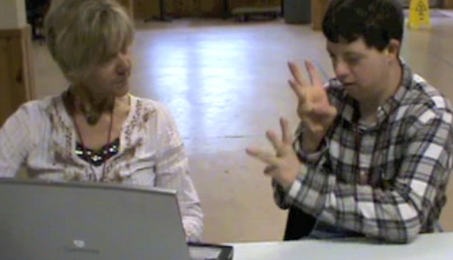
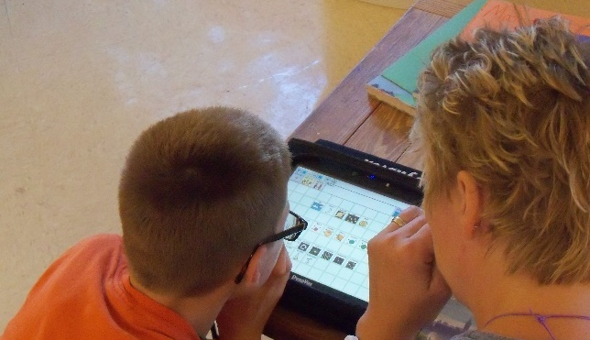


Dynamic Learning Maps® (DLM®)
Spring 2025 Assessments for District of Columbia Test Administrators
© 2025 Accessible Teaching, Learning, and Assessment Systems (ATLAS), the University of Kansas

Slide 2
Spring 2025 Administration of DLM Science Testlets
Required spring window: March 10th – April 25th
  Eligible students in grades 5, 8, and high school biology.

Slide 3
Important Information (1)
The Test Security Agreement must be completed each school year.
Required Test Administrator Training must be completed by new and returning teachers.
The student will be enrolled by OSSE or the LEA depending on grade.

Slide 4
Important Information (2)
The student will be rostered by OSSE to available teacher accounts.
The student’s First Contact survey must be completed by the teacher.
The student’s Personal Needs and Preferences profile will be completed by the teacher if needed.

Slide 5
Required Test Administrator Training

Slide 6
Training Access
Teachers will use the Training tab in Educator Portal to access the DLM Required Test Administrator Training.
  Access to the Test Management tab in Educator Portal is permitted about 30 minutes after accepting the completion certificate in the training course.

Slide 7
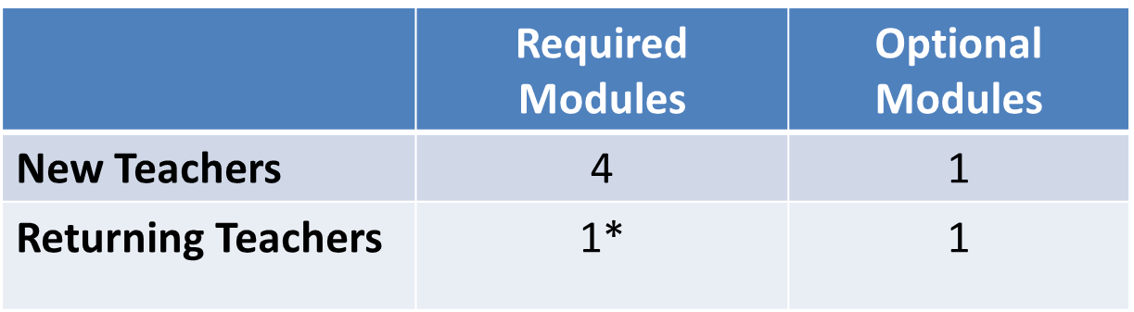
Required Test Administrator Training
Modules
*If the module is not passed, the returning teacher is directed to additional required training.

Slide 8
Teacher Preparation & Data Management

Slide 9
Educator Portal Information
Educator Portal is a web-based system that manages student data and retrieves reports.
The following browsers support Educator Portal for the 2024–2025 school year.
  Mozilla Firefox
  Google Chrome
  Microsoft Edge
  Safari

Slide 10
Accessing Educator Portal
Access Educator Portal at https://educator.kiteaai.org
A test coordinator must add new test administrator accounts.

Slide 11
Educator Portal Account Activation
New teachers must activate their account in Educator Portal using the activation email.
All teachers, new or returning, must agree to security standards in Educator Portal.
  The Security Agreement pops up the first time a teacher logs in to Educator Portal for the new school year.
  A teacher who does not agree to the security standards will not be able to administer testlets.

Slide 12
Verify Student Enrollment
Use the Students tab to
  check the spelling of student name and other demographic information
  view and edit PNP Profile
  view and edit First Contact survey
  view Kite® Student Portal login username and password
Contact the test coordinator if changes to student data are needed.

Slide 13
Verify Student Rosters
Rosters connect an enrolled student to the test administrator.
Test administrators must have an active Educator Portal account to be added to a roster.
If you are missing students from your roster, contact your test coordinator for assistance.

Slide 14
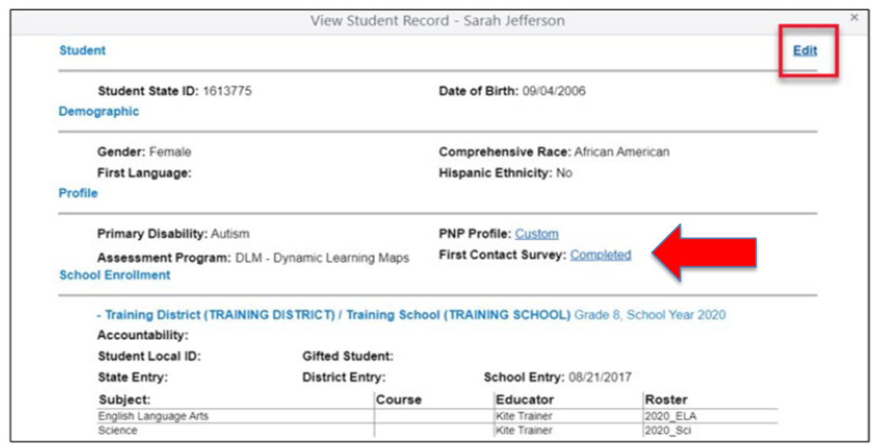
Complete the First Contact Survey and PNP Profile
Complete and submit the First Contact Survey and Personal Needs and Preferences (PNP) Profile for all rostered students in Educator Portal.

Slide 15
First Contact Survey
Completed for each student every school year
Includes questions about a student’s communication, academic, and attention skills
Used to determine the linkage level for the student’s first testlet in each subject
Reviewed, revised, and resubmitted each year

Slide 16
Personal Needs and Preferences (PNP) Profile
The PNP lists a variety of accessibility supports available to the student.
Only select the supports a student needs and uses regularly during instruction.
Guidelines at the state level are provided to assist IEP teams when making decisions about accessibility supports.
Test administrator may adjust the PNP Profile selections between testlets.

Slide 17
PNP Profile Help
The test coordinator can provide further IEP guidance if needed.

Slide 18

Kite® Student Portal
Kite Client v11.0 will be used in 2024–2025.
Android client is now available.
– If you plan to use Android tablets for the 2024–2025 school year, please contact the DLM Service Desk to discuss this compatibility.

Slide 19
DLM Testing Readiness and Data Management Checklist
Activate your Educator Portal account or login if you are an existing user.
Complete the required test administrator training.
Verify that you see all your students in Educator Portal.
Complete the First Contact Survey and if applicable the Personal Needs and Preferences Profile for each of your students.
Verify that Student Portal is installed on any testing devices used for DLM.

Slide 20
Administration of DLM Science Testlets

Slide 21
Time Commitment for the Administration of DLM Science Testlets
9 -10 testlets per student
  Each testlet assesses ONE of the Currently Tested Essential Elements for Science
3 – 5 multiple-choice items per testlet
  Each testlet begins with an engagement activity
5 – 15 minutes per testlet
  The total administration time needed is approximately 45–135 minutes

Slide 22
DLM Science Essential Elements
Science Essential Elements have three linkage levels:
  Initial, Precursor, and Target
DLM science testlets are written by linkage level
Each testlet assesses one Essential Element at one linkage level

Slide 23
Engagement Activities for Science Testlets
Short setup: Read once.
Longer story: Read twice.
Short video: Approximately 30 seconds.

Slide 24
Purpose of Engagement Activities
Establish a context
Activate prior knowledge
Engage the student

Slide 25
Adaptive Testlets
First testlet
  First Contact survey determines the linkage level
Subsequent testlets
  System adapts the linkage level based on student performance
  One level higher, one level lower, or the same level
  Testlets take up to 15 minutes to be generated

Slide 26
Finding Testlets in Educator Portal

Slide 27
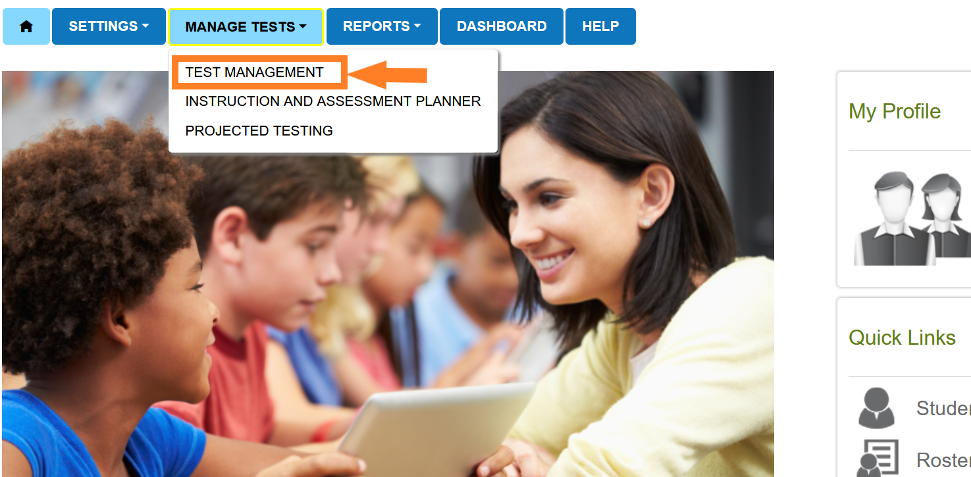
Educator Portal: Test Management

Slide 28
Test Management During the
Spring Assessment Window
The Test Management tab is where test administrators will find:
  assigned science testlets
  test ticket information for rostered students
  TIPs for testlets that have been assigned to rostered students
  testlet administration completion status

Slide 29
Test Ticket Information
A test ticket with student login information is needed for testlet administration in Student Portal.
Download multiple test tickets into one PDF by selecting multiple students.
If you are missing test tickets
  Verify the student is rostered to you and has a completed First Contact Survey.

Slide 30
Testlet Information Pages (TIPs)
TIPs provide test administrators with information specific to each testlet including
  if the testlet is computer-delivered or teacher-administered
  materials needed and how they can be used
Test administrators must download TIPs

Slide 31
Monitoring Student Progress During the
Spring Assessment Window
Testlet completion status can be monitored in three ways:
  Educator Portal: Test Progress column on the Test Management screen
  Educator Portal: DLM Test Administration Monitoring data extract on the Data Extracts tab
  Student Portal: When the testlet is submitted

Slide 32
Data Extracts and reports

Slide 33
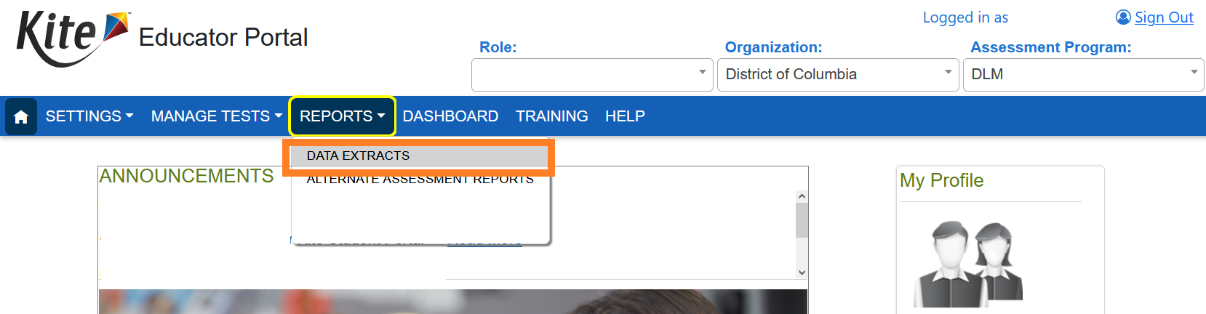
Educator Portal: Extracts

Slide 34
DLM Test Monitoring Extract
This extract tracks completion of assessments in the spring and lists
  the number of end-of-year testlets not started
  the number of end-of-year testlets completed
  the number of testlets required

Slide 35
First Contact Survey File Extract
This extract lists information for each student rostered to you, including
  all responses selected in the First Contact survey
  the status of the First Contact survey (not started, in progress, ready to submit, or submitted)
  the date and name of the last person to modify the First Contact survey for the student

Slide 36
Student Roster and First Contact Survey
Status Extract
This extract provides testing readiness information in one extract and lists the
  grade
  rostered subjects
  First Contact survey status and completion date

Slide 37
Managing Data Verification and Revisions
Data cleanup means asking the following questions:
  Are any students rostered to me who should not be taking the DLM alternate assessment?
  Are there any students not rostered to me who will be taking the DLM alternate assessment?
Contact your test coordinator for assistance with adding, editing, or removing student data

Slide 38
Important Reminders

Slide 39
Protect Student Data Privacy
Do not violate the Family Education Rights and Privacy Act (FERPA).
In emails and live chat, do not include student Personally Identifiable Information (PII).
If you need to communicate student PII, contact the Service Desk by phone or use secure communication protocols set up by OSSE.

Slide 40
DLM Service Desk Contact Information
Phone: 1-855-277-9751 (toll-free)
Email: DLM-support@ku.edu
Live Chat: Kite Educator Portal
Availability: Mon–Fri, 7:00 a.m.–5:00 p.m., Central Time
Student Portal testing environment issues
Test administration issues
Any issues with your rosters or student demographic information should be directed to your test coordinator for assistance.

Slide 41
Key Test Administration Dates

Slide 42
Key Dates (1)
Jan 6 – Jan 31: OSSE enrolls grade 5 and grade 8 DLM-eligible students; LEAs enroll DLM eligible high school students
Jan 15 – Jan 31: Teacher accounts added or updated in Kite Educator Portal by test coordinators
Feb 3 – Feb 14: OSSE rosters students eligible for DLM assessment to available teacher accounts

Slide 43
Key Dates (2)
Feb 17: Start window for First Contact survey and PNP Profile completion by teachers
  Must be completed prior to testing; LEAs verify DLM student rosters
March 10: DLM testing window opens
April 25: DLM testing window closes

Slide 44
Key Dates (3)
Ongoing: Required Test Administrator Training
  Required to access student data and complete the First Contact survey, PNP Profile settings, and to administer testlets
Ongoing: School Test Security Plan submission to LEA/OSSE
  Must be sent to OSSE at least 15 business days prior to testing
Ongoing: Continuous monitoring of student data; communicating with your test coordinator for assistance as needed

Slide 45
Thank you

