Slide 1
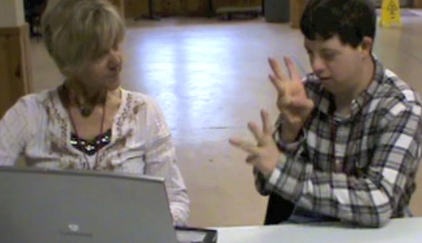
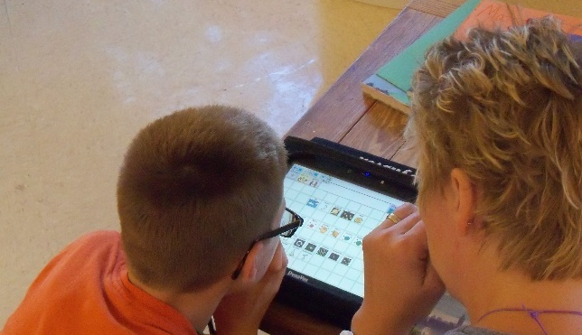


Dynamic Learning Maps® (DLM®) Spring 2026 Assessments for District of Columbia Test Coordinators
© 2026 Accessible Teaching, Learning, and Assessment Systems (ATLAS), the University of Kansas

Slide 2
Topics
DLM testing window dates
Kite® Suite updates
Science field testing overview
Required Test Administrator Training
DLM roles & resources
Managing data in Educator Portal
Administration of science testlets
Important reminders and key dates

Slide 3

Spring 2026 DLM Assessment Window
Required spring window:
March 9, 2026 – April 24, 2026
Eligible science students in grades 5, 8, and high school biology.

Slide 4
Kite® Suite Updates

Slide 5
Kite Student Portal Installation Updates
Chrome and Windows will use the same Student Portal app for the 2026 school year.
Windows 10 is no longer supported. The app may still run on Windows 10 devices; however, support will be limited.
iPad and Mac have no updates for 2026
Review the document Kite Student Portal Updates for 2026 using the Kite Suite link on the DLM website.

Slide 6
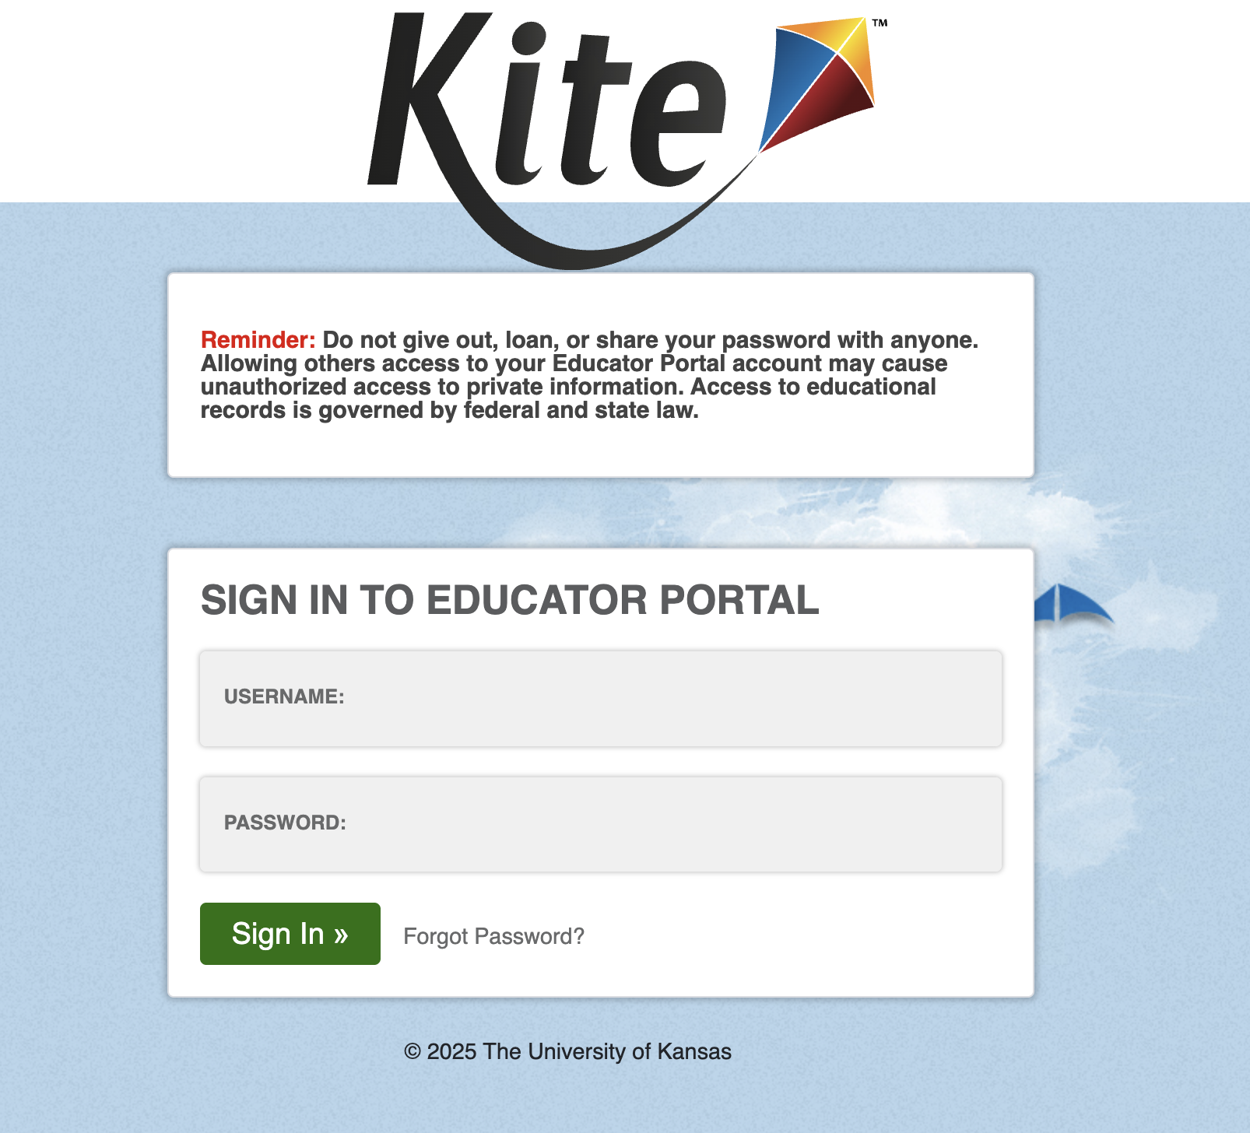
Educator Portal Multifactor Authentication (MFA)(1)
Enter valid username and password.
Select Sign In.
System sends an MFA access code via email.

Slide 7
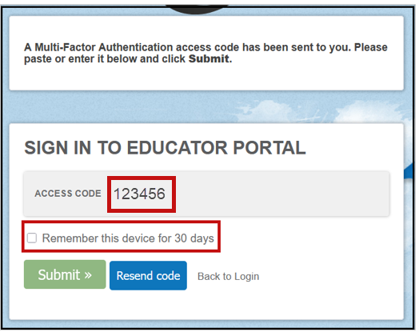
Educator Portal Multifactor Authentication (2)
Enter the access code.
Select the checkbox for remembering the code on this device for 30 days (optional).
Select Submit.
User is logged in to the system.

Slide 8
Educator Portal Multifactor Authentication (3)
If cookies are cleared from the web browser, Educator Portal will require the access code to be entered again even if the option to remember the device for 30 days was selected.
Review the Educator Portal announcement from September 26, 2025.

Slide 9
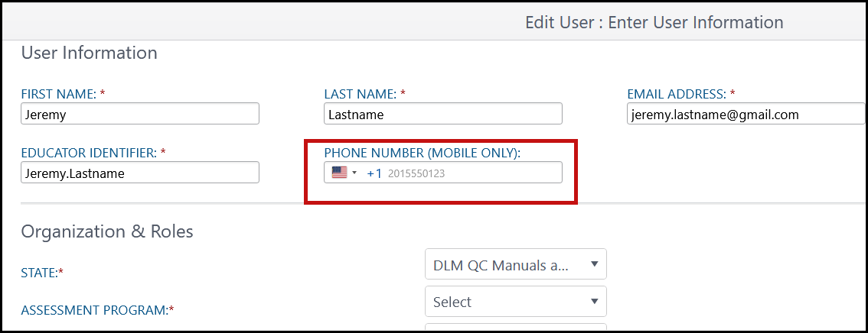
New Phone Number Field in Add/Edit User
Available Now
Looking Ahead
Option for users to receive MFA access code on their cell phone via SMS will be implemented in a future year. Users can continue with email.

Slide 10
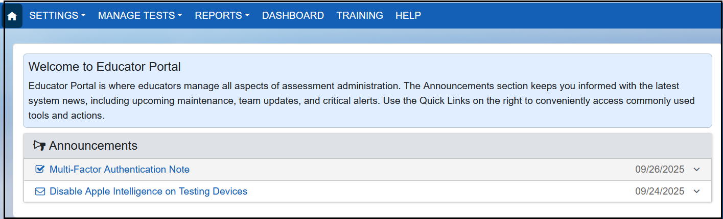
Educator Portal Home Page Update

Slide 11
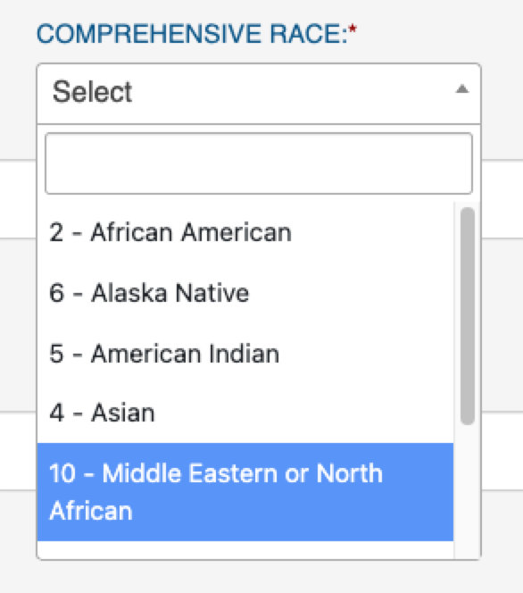
New Value Added to Comprehensive Race in Student Enrollment
The following value has been added to the Comprehensive Race options in student enrollment:
10 = Middle Eastern or North African

Slide 12
New Error Message To Help Prevent Duplicate Student Enrollments (1)
When uploading students using the Enrollment Upload Template file, the enrollment record was flagged if another student had matching first name, last name, gender, and date of birth but a different SSID.
Although an alert message was generated, a duplicate student record was still created.

Slide 13
New Error Message To Help Prevent Duplicate Student Enrollments (2)
A new error message is now generated to help prevent duplicate enrollments.
Review the records and make any needed edits.

Slide 14
New Error Message To Help Prevent Duplicate Student Enrollments (3)
Error message
A student record for the current or a previous school year already exists in your state with a matching first name, last name, gender, and date of birth, but a different State Student Identifier. Contact your State Assessment Administrator for help in correcting the data.

Slide 15
Extract and Upload Template Headers Labels and Order
Goals
Consistent column headers and order for upload template files
Consistent field names across extracts (when applicable)
Consistent column order (when applicable)
Be sure to use only the upload templates for 2025–2026.

Slide 16
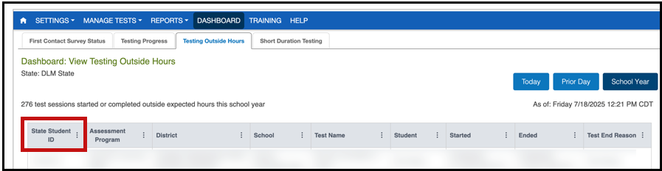
State Student ID Added to Testing Outside Hours Dashboard

Slide 17
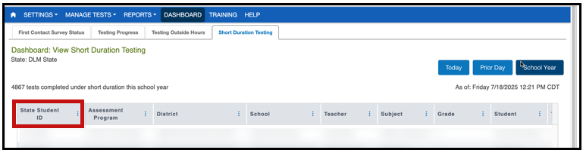
State Student ID Added to Short Duration Testing Dashboard

Slide 18
Science Field testing for 2026

Slide 19
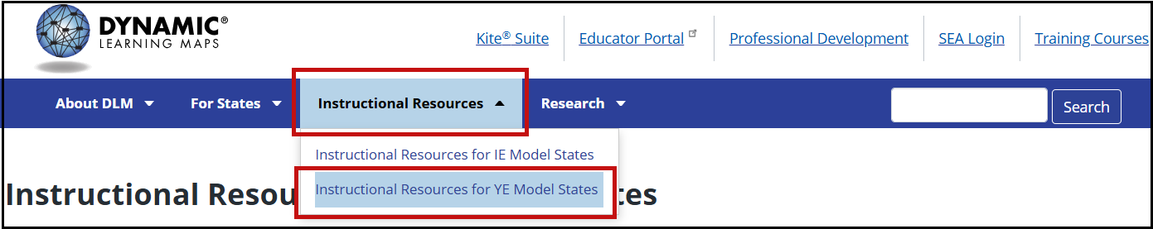
Important Notice for Science (1)
Go to the Instructional Resources tab and select Instructional Resources for Year-End Model States.

Slide 20
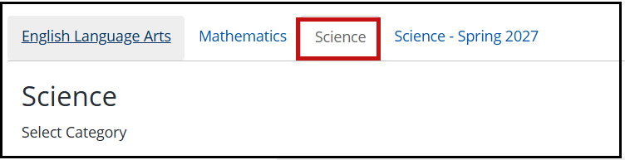
Important Notice for Science (2)
Two science tabs are included to help with this transition.

Slide 21
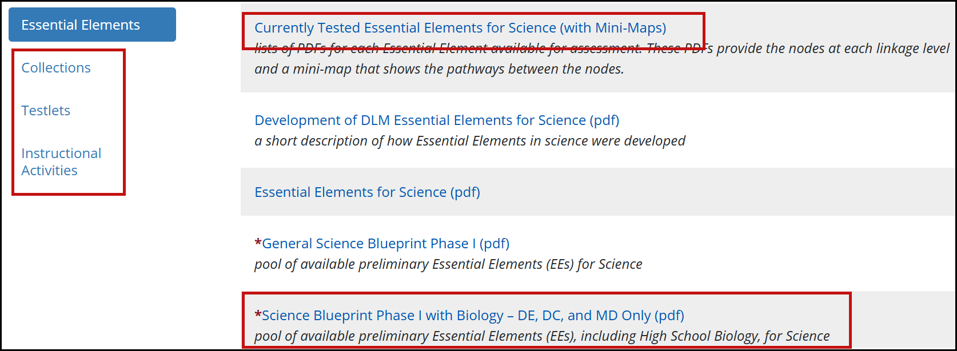
Important Notice for Science (3)

Slide 22
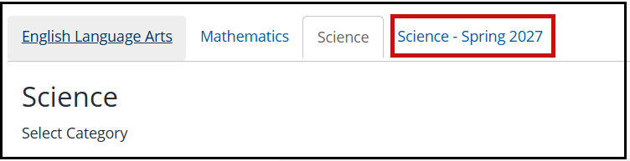
Important Notice for Science (4)
Go to the Science - Spring 2027 tab.

Slide 23
Important Notice for Science (5)
Embedded Science Field Test Testlets Spring 2026
All students, all grade bands
Four science field test testlets per student
Delivered in two sets of two testlets each
Available at the opening of the window
Can be taken any time during the window

Slide 24
Important Notice for Science (6)
Field tests will have four linkage levels:
Initial Precursor
Distal Precursor
Proximal Precursor
Target

Slide 25
Required Test Administrator Training

Slide 26
Required Test Administrator Training Modules (1)
Open Date: December 1, 2025
Close Date: April 24, 2026
Access: Test Administrators need an Educator Portal account to access and complete the training. The required training link is found on the Training tab on the home screen.

Slide 27
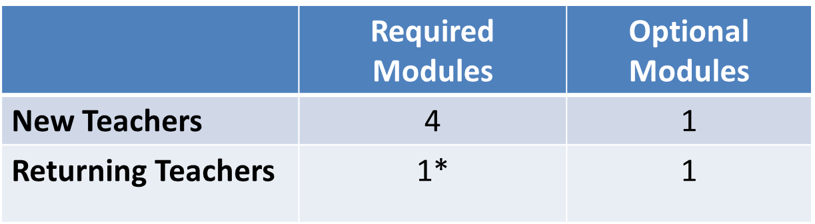
Required Test Administrator Training Modules (2)
*If the module is not passed, the returning teacher is directed to additional required training.

Slide 28
DLM Roles & Resources

Slide 29
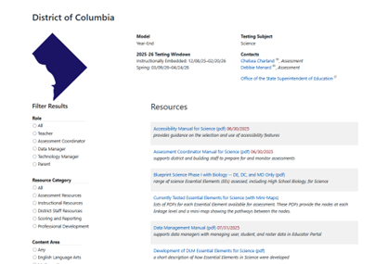
Locating District of Columbia Resources on the DLM Website
All DLM resources can be found on DC’s DLM webpage
Use filtering options on the left panel to locate related documents faster
Links to DLM Professional Development website and scoring and reporting documents

Slide 30
Resources for Teachers on the DLM Website
Manuals
Test Administration Manual for Science
Accessibility Manual for Science
Educator Portal User Guide
Educator Resource Page
Test blueprints and Currently Tested Essential Elements

Slide 31
Resources for Technology Personnel on the DLM Website
Manuals
Kite Suite Technology Requirements
Technology specifications manual
Kite Suite link
Kite system status
Supported platforms
Installation instructions
Troubleshooting Kite upload errors

Slide 32
Resources for Test (Assessment) Coordinators on the DLM Website
Manuals
Assessment Coordinator Manual for science
Accessibility Manual for Science
Guide to DLM Required Test Administrator Training
Test Administration Manual for Science
Educator Portal User Guide

Slide 33
Resources for Data Managers on the DLM Website
Manuals
Data Management Manual
Educator Portal User Guide
Templates
State Organizational Table
Upload Templates

Slide 34
Additional Training
DLM Training for District Roles
short, interactive lessons for assessment coordinators, data managers, technology managers, and district and building administrators

Slide 35
Managing Data in Educator Portal

Slide 36
Data Verification and Revisions
Test coordinators should verify accuracy of data and make changes as necessary.
Data changes can be made anytime before or during the assessment window.

Slide 37
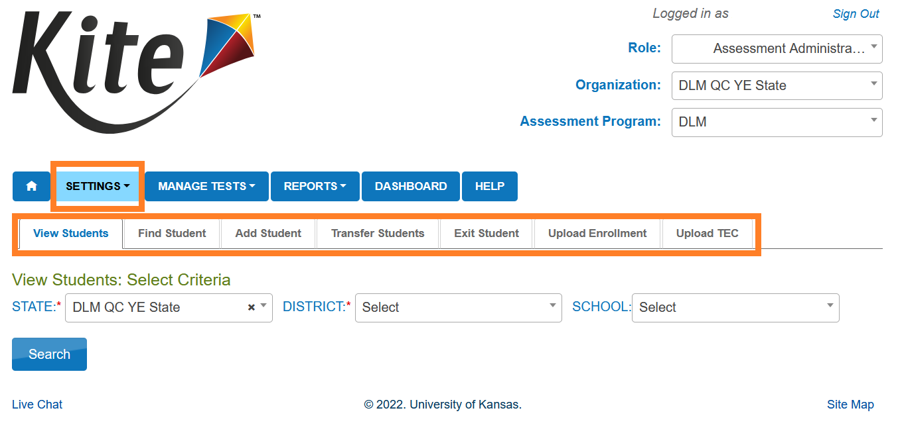
Where to Complete Data Management Tasks

Slide 38
Managing User Account Data (1)
New users need to be added manually or by using a file upload.
Educator Portal sends an activation email to the new user with a link to create a password.
The user’s email address is the unique account key.

Slide 39
Managing User Account Data (2)
Users may have more than one role in Educator Portal.
Users are rolled over from the year before.
Deactivation of user accounts may be done manually or by using the user upload template.

Slide 40
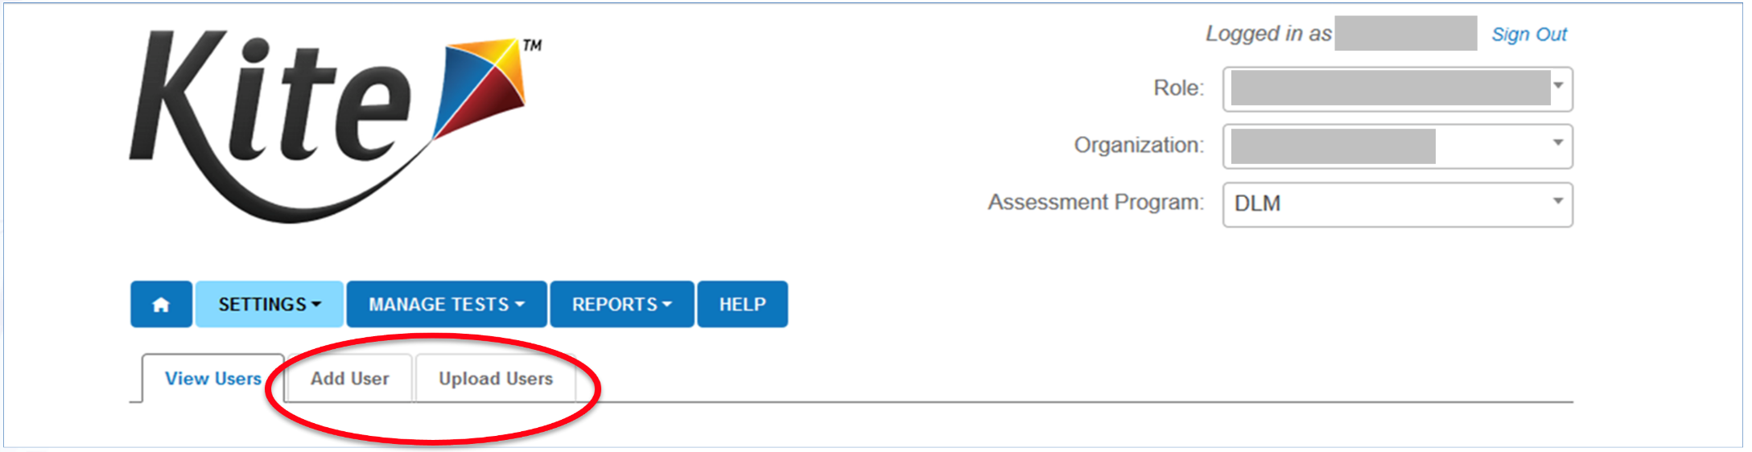
Add User Accounts
Add User: manually add a few users
Upload Users: add users with an upload template

Slide 41
Edit User Accounts
Common changes for users include
organization assignment
email address
add or remove roles
Manually edit when a few users need changes.
Use the upload template when more than a few users need changes.
Updated information only affects users in the upload.

Slide 42
Resending the Account Activation Email to Users
The most common reasons the Kite activation email would need to be resent
A user did not receive the email or accidentally deleted the email.
The user did not activate the account within 20 days of receiving the email.
Video: Adding and Editing Users

Slide 43
Adding Students
All students required to take the DLM assessment need to be added to Educator Portal
Students can be added using the Educator Portal user interface or by using an upload template.
OSSE enrolls grades 5 & 8 DLM-eligible students
LEAs enroll eligible HS biology students
New eligibility cases added as needed

Slide 44
Edit a Student
Manually edit when a few students need changes.
Use the upload template when more than a few students need changes.
The upload will only update information for students in the upload.

Slide 45
Exit a Student
A student must be exited from Educator Portal when the student is
leaving District of Columbia, leaving the LEA with an unknown destination, or is no longer taking the DLM alternate assessment
Exiting is not applicable to students who are remote and cannot test.
Exits can be done manually or using the Test, Exit, Clear (TEC) upload.

Slide 46
Rostering (1)
Rosters connect a student to a teacher in Educator Portal.
New students can be added to an existing roster.
The teacher on a roster can be changed.

Slide 47
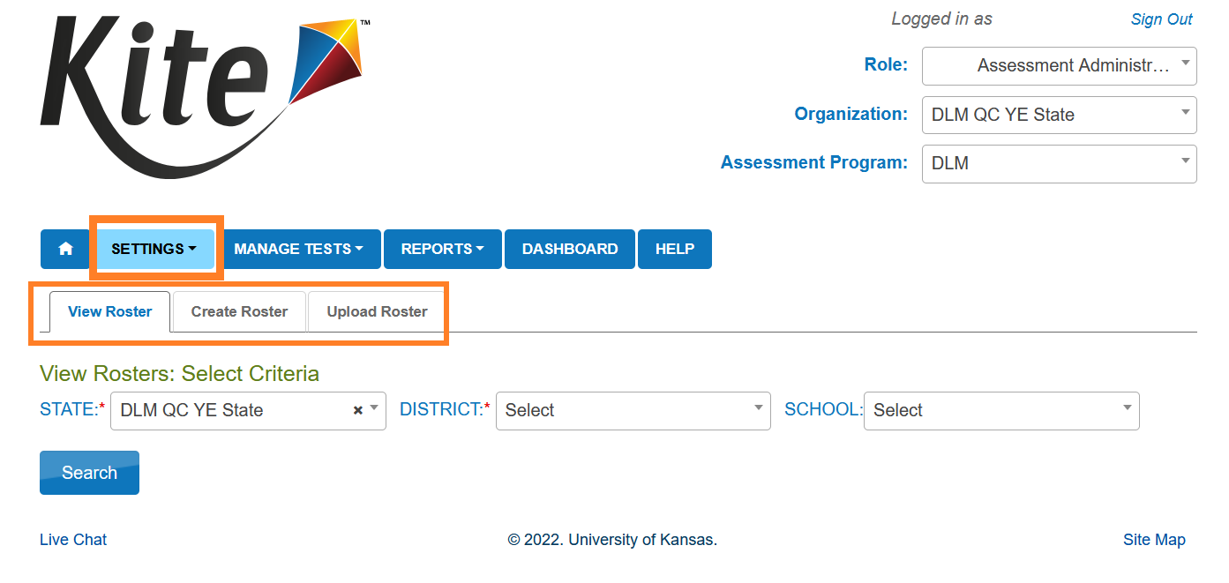
Rostering (2)

Slide 48
Rostering (3)
Rostering for high school biology
select biology as the course
Roster high school students separately from elementary and middle school students

Slide 49
Administration of DLM Science Testlets

Slide 50
Time Commitment for the Administration of DLM Science Testlets
9 -10 testlets per student
3 – 5 multiple-choice items per testlet
Each testlet begins with an engagement activity
5 – 15 minutes per testlet
The total administration time needed is approximately 45–135 minutes

Slide 51
DLM Science Essential Elements
Science Essential Elements have three linkage levels: Initial, Precursor, and Target
DLM science testlets are written by linkage level
Each testlet assesses one Essential Element at one linkage level

Slide 52
Engagement Activities for Science Testlets
Establish a context, activate prior knowledge, engage the student
Short setup: Read once.
Longer story: Read twice.
Short video: Approximately 30 seconds.

Slide 53
Adaptive Testlets
First testlet linkage level is determined by the First Contact Survey
Subsequent testlets adapt based on student performance.
One level higher, one level lower, or the same level
Testlets take up to 15 minutes to be generated
Teachers should use this time to take a break with the student.

Slide 54
Test Management

Slide 55
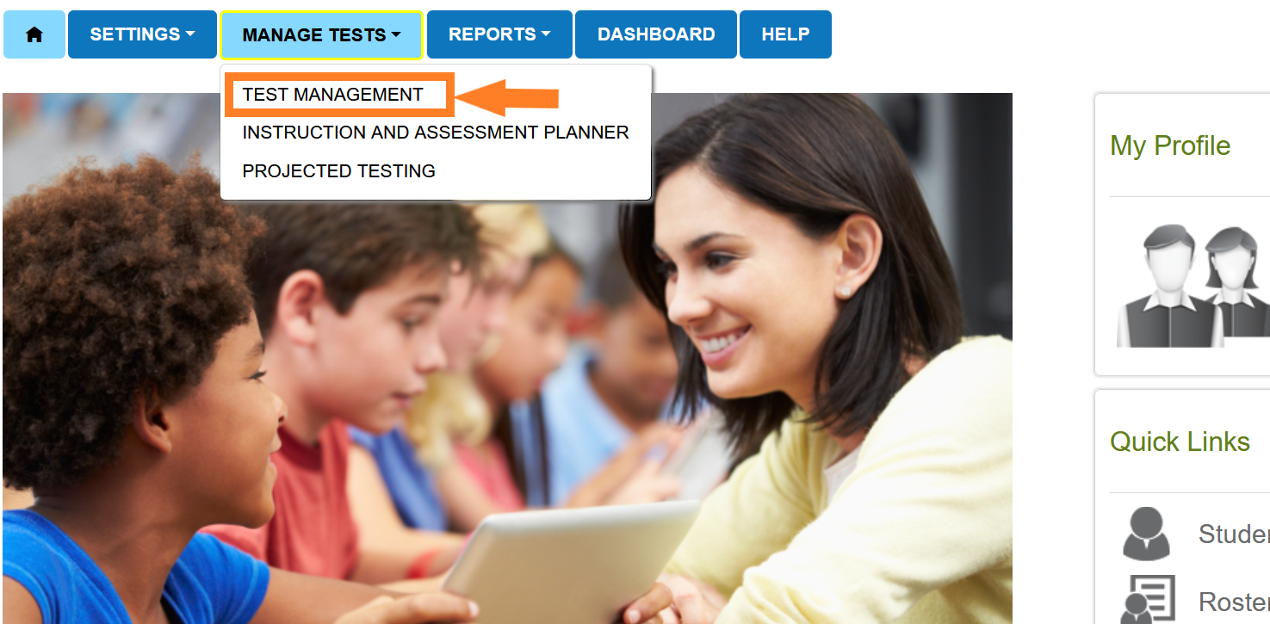
Educator Portal: Test Management

Slide 56
Test Management During the Spring Assessment Window
The Test Management tab is where test administrators will find:
assigned science testlets
test ticket information for rostered students
TIPs for testlets that have been assigned to rostered students
testlet administration completion status
If a student does not have testlets check that the student is rostered and has a submitted First Contact Survey.

Slide 57
Test Ticket Information
Test tickets are in Educator Portal.
A test ticket with student login information is needed for testlet administration in Student Portal.
Test ticket information for rostered students is found on the Test Management tab.
Select the PDF icon in the Tickets column to view the test ticket for a student.

Slide 58
Testlet Information Pages (TIPs)
TIPs provide test administrators with information specific to each testlet including
if the testlet is computer-delivered or teacher-administered
materials needed and how they can be used
Test administrators must download TIPs

Slide 59
Monitoring Student Progress During the Spring Assessment Window
Testlet completion status can be monitored in three ways:
Educator Portal: Test Progress column on the Test Management screen
Educator Portal: DLM Test Administration Monitoring data extract
Student Portal: When the testlet is submitted

Slide 60
Data Extracts and reports

Slide 61
Extracts
Use the Student Roster and First Contact Survey Status extract to monitor whether students are rostered correctly and when the First Contact Survey was completed.
Use the DLM Test Administration Monitoring extract to monitor testing progress.
Use the TIP Access extract to ensure the TIPs are being accessed.

Slide 62
Short Duration Testing
The timespan displays Hour: Minutes: Seconds 00:00:00 for each subject and is updated twice daily.
The minimum number of seconds for each subject is
Science: 30 seconds
A test session will appear on the Short Duration Testing report if the duration is the same or shorter than the minimum number of seconds.

Slide 63
Important Reminders

Slide 64
Important Information (1)
The Test Security Agreement must be completed each school year.
Required Test Administrator Training must be completed by new and returning teachers.
The student will be enrolled by OSSE or the LEA depending on grade.

Slide 65
Important Information (2)
The student will be rostered by OSSE to available teacher accounts.
The student’s First Contact survey must be completed by the teacher.
The student’s Personal Needs and Preferences profile will be completed by the teacher if needed.

Slide 66
Protect Student Data Privacy
Do not violate the Family Education Rights and Privacy Act (FERPA).
In emails and live chat, do not include student Personally Identifiable Information (PII).
If you need to communicate student PII, contact the Service Desk by phone or use secure communication protocols set up by OSSE.

Slide 67
DLM Service Desk Contact Information
Phone: 1-855-277-9751 (toll-free)
Email: DLM-support@ku.edu
Live Chat: Kite Educator Portal
Availability: Mon–Fri, 7:00 a.m.–5:00 p.m., Central Time
Student Portal testing environment issues
Test administration issues
Any issues with your rosters or student demographic information should be directed to your data manager or state assessment administrator.

Slide 68
Key Test Administration Dates

Slide 69
Key Dates (1)
Beginning Dec 1: OSSE will be notifying LEA Assessment Managers (LAMs) of current school/LEA staff accounts in KITE.
Note that the DLM KITE portal does not automatically import information from AllStaff IDS. The following actions should be taken by the LAM:
Remove Accounts: For personnel that are no longer active or associated with DLM at the campus and/or the LEA.
Add Accounts: For new school-based test coordinators and teachers.
Update Accounts: Name and/or role changes. Please note that there can only be one “Building Test Coordinator” listed for each school site.

Slide 70
Key Dates (2)
Jan 5–30:
OSSE enrolls grades 5 & 8 DLM-eligible students
LEAs enroll eligible HS biology students
New eligibility cases added as needed
Feb 2 onward:
OSSE conducts weekly audits to remove ineligible students
Non-eligible students require OST ticket; will count as non-participants

Slide 71
Key Dates (3)
By Jan 30: Update teacher accounts in Kite Educator Portal
Feb 2 onward: Bi-weekly audits for teacher readiness
Schools must have at least one active teacher with passing required DLM training scores. LEAs that have not demonstrated teacher readiness requirements will be notified bi-weekly until completed
Feb 16: First Contact survey & PNP Profile window opens
Complete at least 24 hours before testing to avoid delay of testing
Mar 9 – Apr 24: DLM testing window

Slide 72
Key Dates (4)
Ongoing: Required Test Administrator Training
Required to access student data, complete the First Contact survey, PNP Profile settings, and to administer testlets.
Ongoing: School Test Security Plan completion and submission
Must be submitted to OSSE via the OST at least 15 business days prior to testing.
Ongoing: Continuous monitoring of student data; communicating with your test coordinator or state assessment administrator for assistance as needed

Slide 73
Thank you

