Slide 1
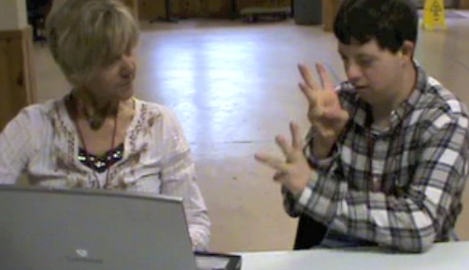
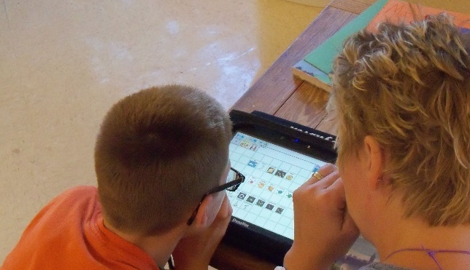


Dynamic Learning Maps® (DLM®) Spring 2026 Assessments for District of Columbia Test Administrators
© 2026 Accessible Teaching, Learning, and Assessment Systems (ATLAS), the University of Kansas

Slide 2
Topics
DLM testing window dates
Kite® Suite updates
Science field testing updates
DLM Required Test Administrator Training
Assessment preparation and administration information
Important reminders

Slide 3

Spring 2026 DLM Assessment Window
Required spring window:
March 9, 2026 – April 24, 2026
Eligible science students in grades 5, 8, and high school biology.

Slide 4
Kite® Suite Updates

Slide 5
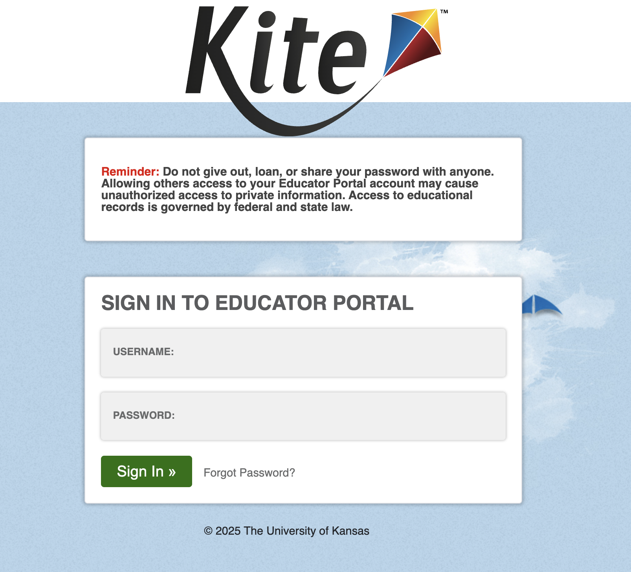
Educator Portal Multifactor Authentication (MFA)(1)
Enter valid username and password.
Select Sign In.
System sends an MFA access code via email.

Slide 6
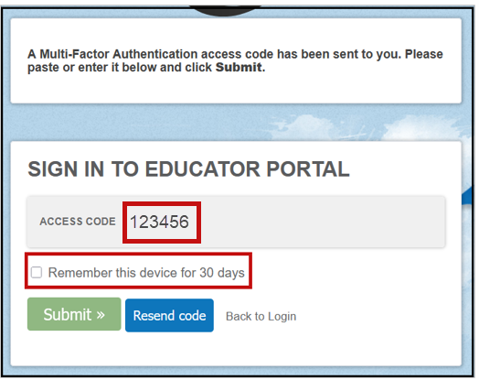
Educator Portal Multifactor Authentication (2)
Enter the access code.
Select the checkbox for remembering the code on this device for 30 days (optional).
Select Submit.
User is logged in to the system.

Slide 7
Educator Portal Multifactor Authentication (3)
If cookies are cleared from the web browser, Educator Portal will require the access code to be entered again even if the option to remember the device for 30 days was selected.
Review the Educator Portal announcement from September 26, 2025.

Slide 8
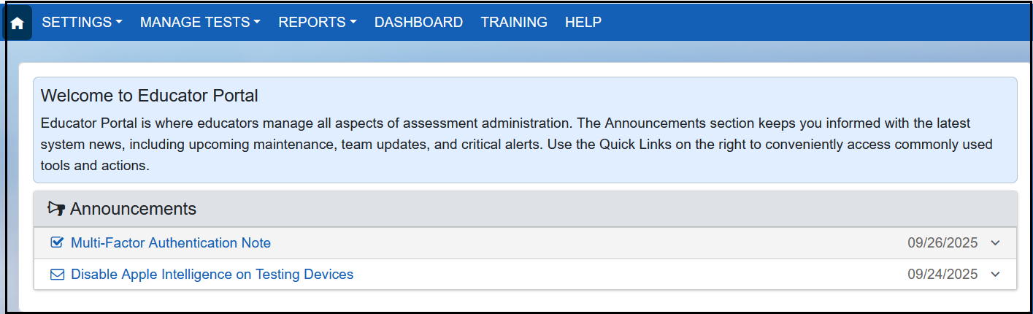
Educator Portal Home Page Update

Slide 9
Science Updates

Slide 10
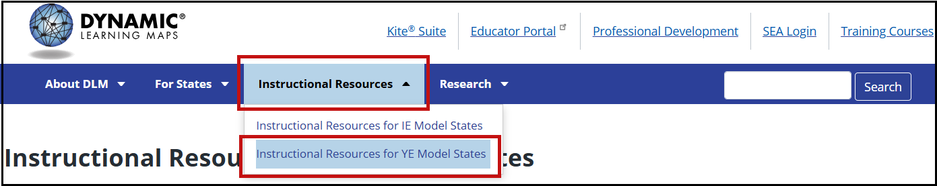
Important Notice for Science (1)
Go to the Instructional Resources tab and select Instructional Resources for Year-End Model States.

Slide 11
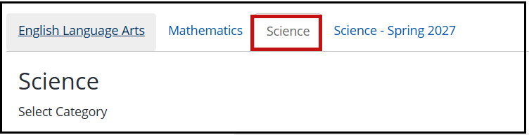
Important Notice for Science (2)
Two science tabs are included to help with this transition.

Slide 12
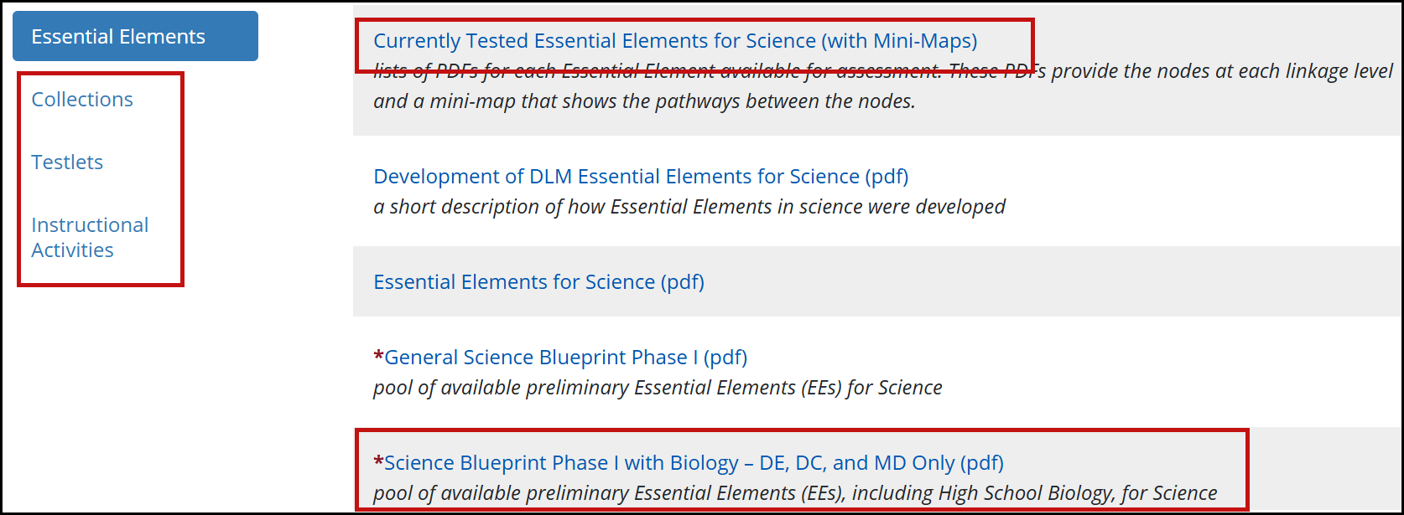
Important Notice for Science (3)

Slide 13
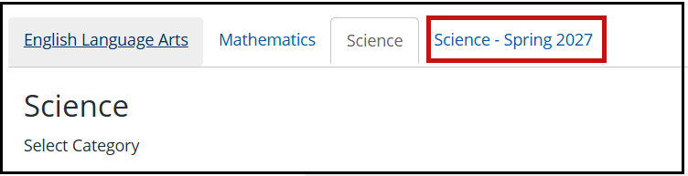
Important Notice for Science (4)
Go to the Science - Spring 2027 tab.

Slide 14
Important Notice for Science (5)
Embedded Science Field Test Testlets Spring 2026
All students, all grade bands
Four science field test testlets per student
Delivered in two sets of two testlets each
Available at the opening of the window
Can be taken any time during the window

Slide 15
Important Notice for Science (6)
Field tests will have four linkage levels:
Initial Precursor
Distal Precursor
Proximal Precursor
Target

Slide 16
Kite Student Portal Installation Updates
Chrome and Windows will use the same Student Portal app for the 2026 school year.
Windows 10 is no longer supported. The app may still run on Windows 10 devices; however, support will be limited.
iPad and Mac have no updates for 2026
Review the document Kite Student Portal Updates for 2026 using the Kite Suite link on the DLM website.

Slide 17
Required Test Administrator Training

Slide 18
Required Test Administrator Training Modules (1)
Open Date: December 1, 2025
Close Date: April 24, 2026
Access: Test Administrators need an Educator Portal account to access and complete the training. The required training link is found on the Training tab on the home screen.

Slide 19
Training Access
Use the Training tab in Educator Portal to access the DLM Required Test Administrator Training.
Access to the Test Management tab in Educator Portal is permitted about 30 minutes after accepting the completion certificate in the training course.

Slide 20
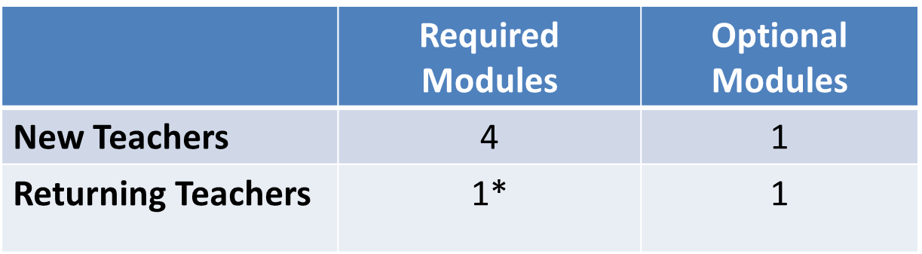
Required Test Administrator Training Modules
*If the module is not passed, the returning teacher is directed to additional required training.

Slide 21
DLM Resources

Slide 22
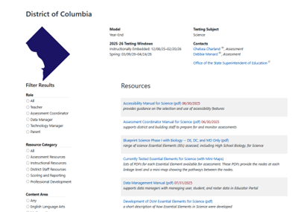
Locating District of Columbia Resources on the DLM Website
All DLM resources can be found on DC’s DLM webpage
Use filtering options on the left panel to locate related documents faster
Links to DLM Professional Development website

Slide 23
Resources for Teachers on the DLM Website
Manuals
Test Administration Manual for Science
Accessibility Manual for Science
Educator Portal User Guide
Educator Resource Page
Test blueprints and Currently Tested Essential Elements

Slide 24
Teacher Preparation & Data Management

Slide 25
Educator Portal Information
Educator Portal is used to manage student data and access extracts.
Access Educator Portal at https://educator.kiteaai.org
A test coordinator must add new test administrator accounts.
The following browsers support Educator Portal for the 2025–2026 school year.
Mozilla Firefox
Google Chrome
Microsoft Edge
Safari

Slide 26
Educator Portal Account Activation
New teachers must activate their account in Educator Portal using the activation email.
All teachers must agree to security standards in Educator Portal.
The Security Agreement pops up the first time a teacher logs in to Educator Portal for the new school year.
A teacher who does not agree to the security standards will not be able to administer testlets.

Slide 27
Verify Student Enrollment
Use the Students tab to
check the spelling of student name and other demographic information
view and edit PNP Profile
view and edit First Contact survey
view Kite® Student Portal login username and password
Contact the test coordinator if changes to student data are needed.

Slide 28
Verify Student Rosters
Rosters connect an enrolled student to the test administrator.
Test administrators must have an active Educator Portal account to be added to a roster.
If you are missing students from your roster, contact your test coordinator for assistance.

Slide 29
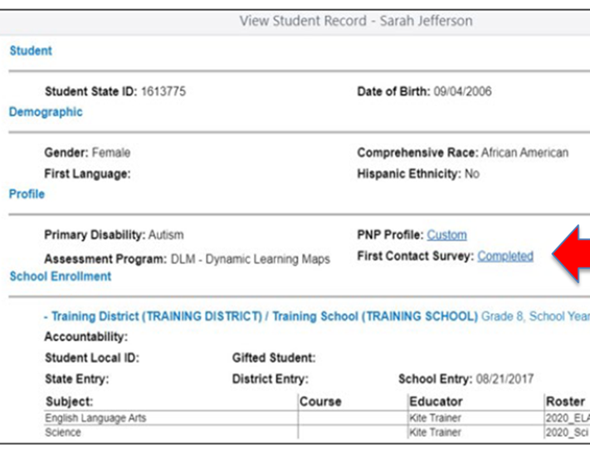
First Contact Survey
Completed for each student every school year
Includes questions about a student’s communication, academic, and attention skills
Used to determine the linkage level for the student’s first testlet in each subject
Reviewed, revised, and resubmitted each year

Slide 30
Personal Needs and Preferences (PNP) Profile
The PNP lists a variety of accessibility supports available to the student.
Only select the supports a student needs and uses regularly during instruction.
Guidelines at the state level are provided to assist IEP teams when making decisions about accessibility supports.
Test administrators may adjust the PNP Profile selections between testlets.

Slide 31
PNP Profile Help
The test coordinator can provide further IEP guidance if needed.

Slide 32
DLM Testing Readiness and Data Management Checklist
Activate your Educator Portal account or login if you are an existing user.
Complete the Required Test Administrator Training.
Verify that you see all your students in Educator Portal.
Complete the First Contact Survey and if applicable the Personal Needs and Preferences Profile for each of your students.
Verify that Student Portal is installed on any testing devices used for DLM.

Slide 33
Managing Data Verification and Revisions
Data cleanup means asking the following questions:
Are any students rostered to me who should not be taking the DLM alternate assessment?
Are there any students not rostered to me who will be taking the DLM alternate assessment?
Contact your test coordinator for assistance with adding, editing, or removing student data

Slide 34
Administration of DLM Science Testlets

Slide 35
Time Commitment for the Administration of DLM Science Testlets
9 -10 testlets per student
Each testlet assesses ONE of the Currently Tested Essential Elements for Science
3 – 5 multiple-choice items per testlet
Each testlet begins with an engagement activity
5 – 15 minutes per testlet
The total administration time needed is approximately 45–135 minutes

Slide 36
DLM Science Essential Elements
Science Essential Elements have three linkage levels:
Initial, Precursor, and Target
DLM science testlets are written by linkage level
Each testlet assesses one Essential Element at one linkage level

Slide 37
Engagement Activities for Science Testlets
Short setup: Read once.
Longer story: Read twice.
Short video: Approximately 30 seconds.

Slide 38
Purpose of Engagement Activities
Establish a context
Activate prior knowledge
Engage the student

Slide 39
Adaptive Testlets
First Contact Survey determines the linkage level of the first testlet
Subsequent testlets
system adapts the linkage level based on student performance
one level higher, one level lower, or the same level
testlets take up to 15 minutes to be generated

Slide 40
Finding Testlets in Educator Portal

Slide 41
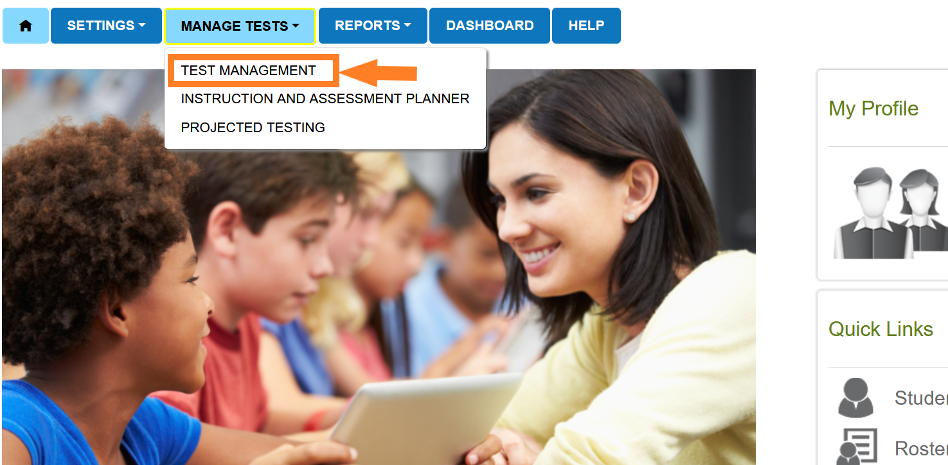
Educator Portal: Test Management

Slide 42
Test Management During the Spring Assessment Window
The Test Management tab is where test administrators will find:
assigned science testlets
test ticket information for rostered students
TIPs for testlets that have been assigned to rostered students
testlet administration completion status

Slide 43
Test Ticket Information
A test ticket with student login information is needed for testlet administration in Student Portal.
Download multiple test tickets into one PDF by selecting multiple students.
If you are missing test tickets
Verify the student is rostered to you and has a completed First Contact Survey.

Slide 44
Testlet Information Pages (TIPs)
TIPs provide test administrators with information specific to each testlet including
if the testlet is computer-delivered or teacher-administered
materials needed and how they can be used
Test administrators must download TIPs

Slide 45
Monitoring Student Progress During the Spring Assessment Window
Testlet completion status can be monitored in three ways:
Educator Portal: Test Progress column on the Test Management screen
Educator Portal: DLM Test Administration Monitoring data extract on the Data Extracts tab
Student Portal: When the testlet is submitted

Slide 46
Data Extracts and reports

Slide 47
Extracts
Use the Student Roster and First Contact Survey Status extract to monitor whether students are rostered correctly and First Contact Survey completion.
Use the DLM Test Administration Monitoring extract to monitor testing progress.

Slide 48
Important Reminders

Slide 49
Protect Student Data Privacy
Do not violate the Family Education Rights and Privacy Act (FERPA).
In emails and live chat, do not include student Personally Identifiable Information (PII).
If you need to communicate student PII, contact the Service Desk by phone or use secure communication protocols set up by OSSE.

Slide 50
DLM Service Desk Contact Information
Phone: 1-855-277-9751 (toll-free)
Email: DLM-support@ku.edu
Live Chat: Kite Educator Portal
Availability: Mon–Fri, 7:00 a.m.–5:00 p.m., Central Time
Student Portal testing environment issues
Test administration issues
Any issues with your student enrollment or rosters should be directed to your test coordinator.

Slide 51
Key Test Administration Dates

Slide 52
Key Dates (1)
Beginning Dec 1: OSSE will be notifying LEA Assessment Managers (LAMs) of current school/LEA staff accounts in KITE.
Note that the DLM KITE portal does not automatically import information from AllStaff IDS. The following actions should be taken by the LAM:
Remove Accounts: For personnel that are no longer active or associated with DLM at the campus and/or the LEA.
Add Accounts: For new school-based test coordinators and teachers.
Update Accounts: Name and/or role changes. Please note that there can only be one “Building Test Coordinator” listed for each school site.

Slide 53
Key Dates (2)
Jan 5–30:
OSSE enrolls grades 5 & 8 DLM-eligible students
LEAs enroll eligible HS biology students
New eligibility cases added as needed
Feb 2 onward:
OSSE conducts weekly audits to remove ineligible students
Non-eligible students require OST ticket; will count as non-participants

Slide 54
Key Dates (3)
By Jan 30: Update teacher accounts in Kite Educator Portal
Feb 2 onward: Bi-weekly audits for teacher readiness
Schools must have at least one active teacher with passing required DLM training scores. LEAs that have not demonstrated teacher readiness requirements will be notified bi-weekly until completed
Feb 16: First Contact survey & PNP Profile window opens
Complete at least 24 hours before testing to avoid delay of testing
Mar 9 – Apr 24: DLM testing window

Slide 55
Key Dates (4)
Ongoing: Required Test Administrator Training
Required to access student data, complete the First Contact survey, PNP Profile settings, and to administer testlets.
Ongoing: School Test Security Plan completion and submission
Must be submitted to OSSE via the OST at least 15 business days prior to testing.
Ongoing: Continuous monitoring of student data; communicating with your test coordinator or state assessment administrator for assistance as needed

Slide 56
Thank you

